Slide 1
COA Lab Project (2016-17) The LNMIIT, Jaipur
S.H.A.K.T.I.M.A.A.N.
(Smart Hardware Application having K Technology Integrated with Memory
And AI Network )
Sumit Madhwani (15ucs146)
Yash Soni (15ucs166)
Priyanka Sharma (15ucs170)
Shubham Kothari (15ucs171)

Slide 2
Introduction
SHAKTIMAAN is a highly advanced computerized A.I. to manage almost everything, especially matters related to technology, in day to day needs in home.
He uses all the technology around him, provided that he is connected with it. He takes care of the house and maintains security and takes preventive measures at the time of emergency.
He takes care of daily works like lights on/off, air conditioning, microwave, reminders, water closet, irrigation, entertainment, etc.

Slide 3
Functions
Light
SetReminder
HVAC
Door
Settings
WeatherForecast
WaterCloset
Reminder

Slide 4
Functions
(…continued)
Entertainment
Irrigation
Info
Kitchen
Fly

Slide 5
Memory Model
Aligned Memory Model
RAM Size – 256 X 16
Little Endian
Word Addressable

Slide 6
Registers
General Purpose Registers– 27
R00 – R26
Special Purpose Registers –
Program Counter, Instruction Register
Status Registers –
An array of length 7: Zero flag, Light1, Light2, Light3, Light4, Positive flag, Negative flag

Slide 7
Instruction Format
2 Address Instructions –
1 Address Instructions –
0 Address Instructions –
OPCODE | OPERAND 1 | OPERAND 2
6 bits 5 bits 5 bits
OPCODE | OPERAND 1
11 bits 5 bits
(Escape code – 6 bits)
OPCODE
16 bits
(Escape code – 6 bits + 5 bits)

Slide 8
Instruction Design
2 Addressable -
LIGHT – 000000 xxxxx yyyyy
HVAC – 000001 xxxxx yyyyy
MOVE – 000010 xxxxx yyyyy
(Escape Code – 111111)
1 Addressable –
DOOR – 111111 00000 xxxxx
SETTINGS – 111111 00001 xxxxx
WEATHERFORECAST – 111111 00010 xxxxx
WATERCLOSET – 111111 00011 xxxxx
FLY – 111111 00100 xxxxx

Slide 9
Instruction Design
(…continued)
SETREMINDER – 111111 00101 xxxxx
(Escape Code – 111111 11111)
0 Addressable –
REMINDER – 111111 11111 00000
ENTERTAINMENT – 111111 11111 00001
IRRIGATION – 111111 11111 00010
INFO – 111111 11111 00011
KITCHEN – 111111 11111 00100

Slide 10
Instruction Types
Data Transfer – Set Reminder, Settings, Reminder
Dyadic Operations – Light, SetReminder, HVAC
Monodic Operations – Door, Settings, WeatherForecast, WaterCloset, Fly
Procedure Call – FLY
Arithmetic - HVAC

Slide 11
Data Types
Numeric –
Integer(signed, unsigned)
Non-numeric –
Boolean

Slide 12
Addressing Modes
Immediate – all 1 and 2 addressable
Example – Door(#password)
Register – all 1 and 2 addressable
Example – WeatherForecast(time)
Stack Based – Fly
Example:- Fly <func_name>

Slide 13
Flow of Control Handling
Fly <func_name>
Unconditional jump to specified function.
Emergency (special register)
Will interrupt the whole process and take some safety measures and then shuts down.

Slide 14
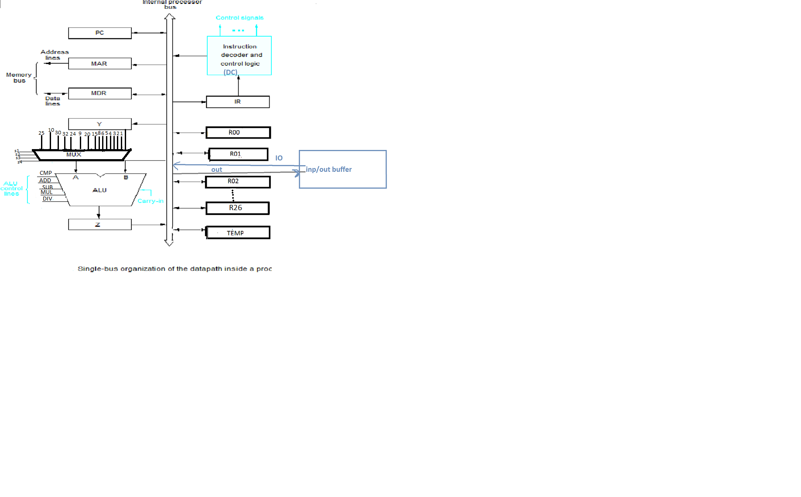

Slide 15
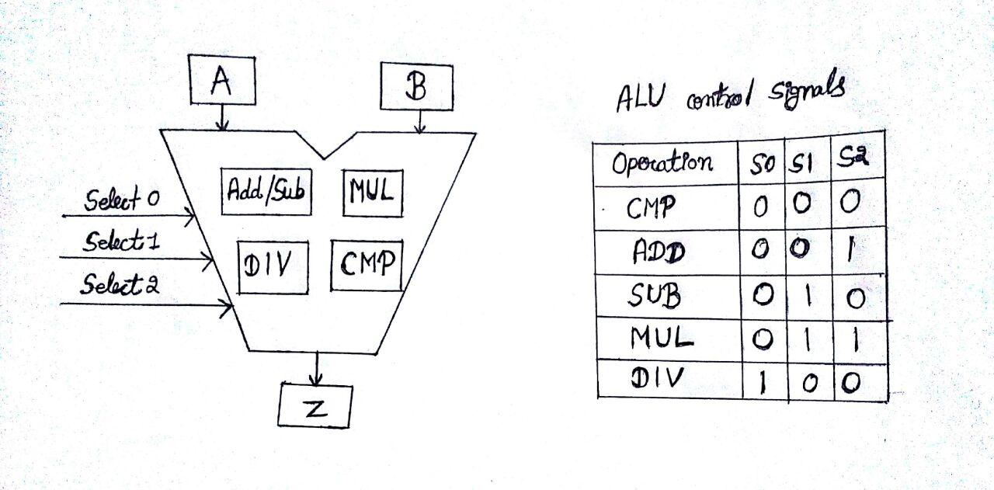

Slide 16
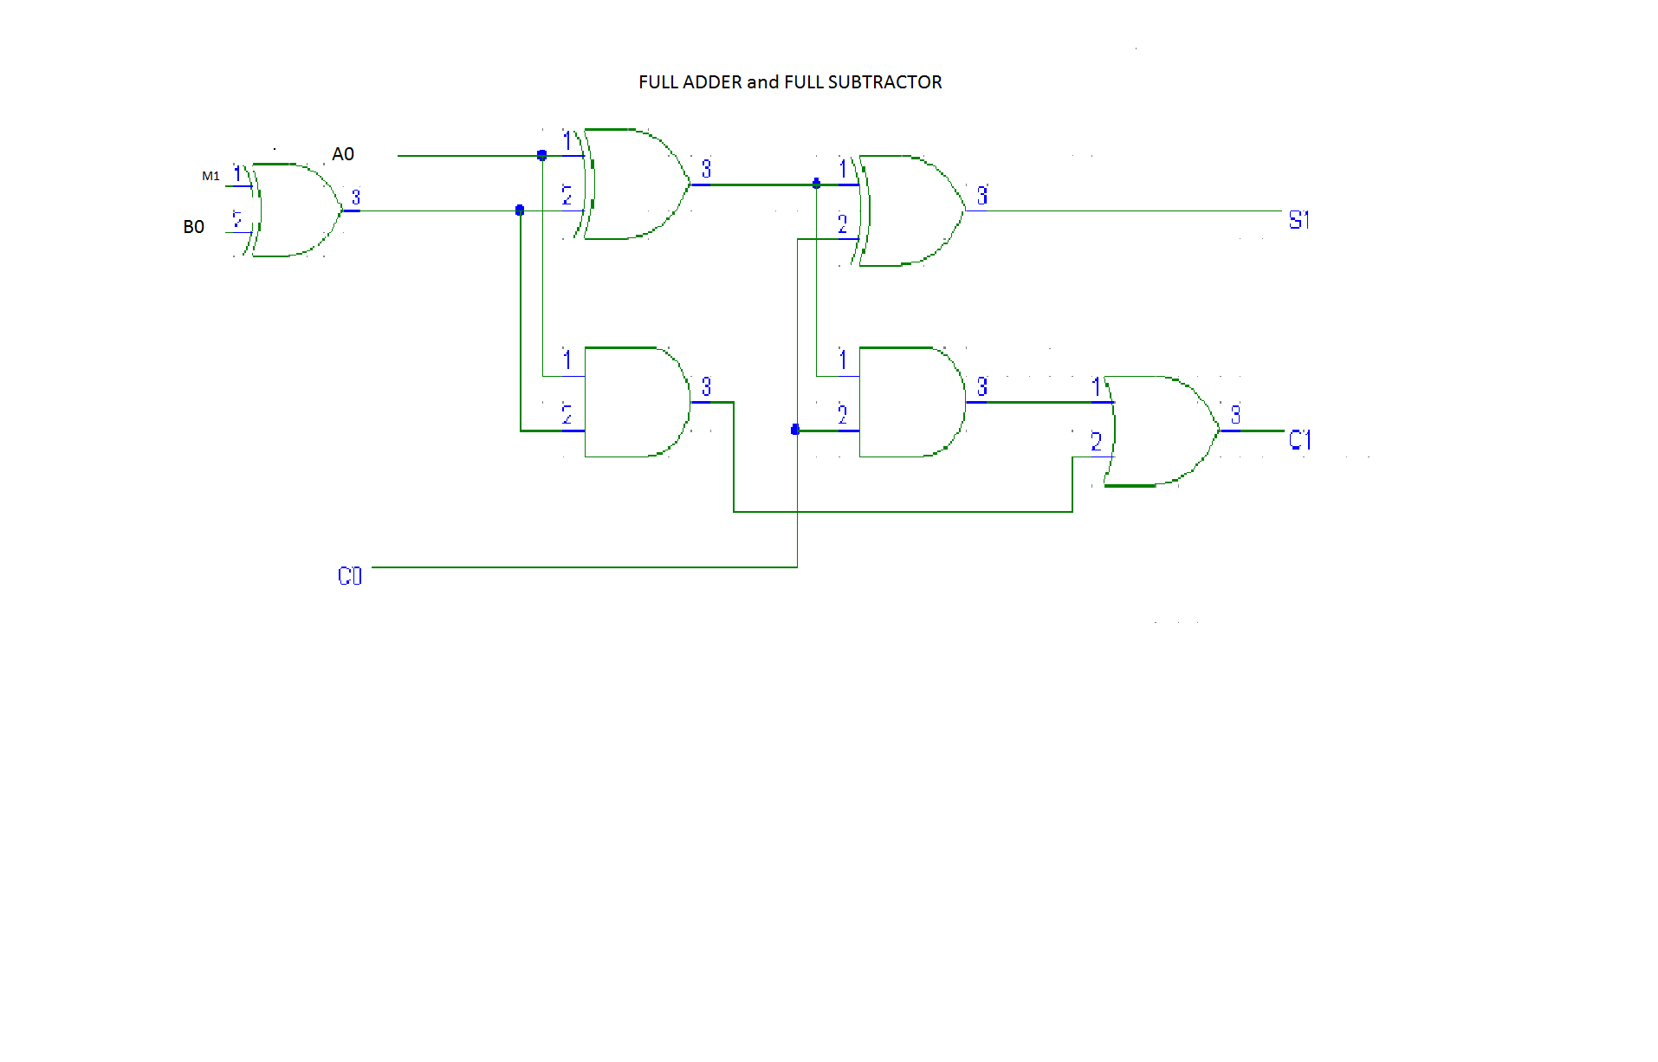

Slide 17
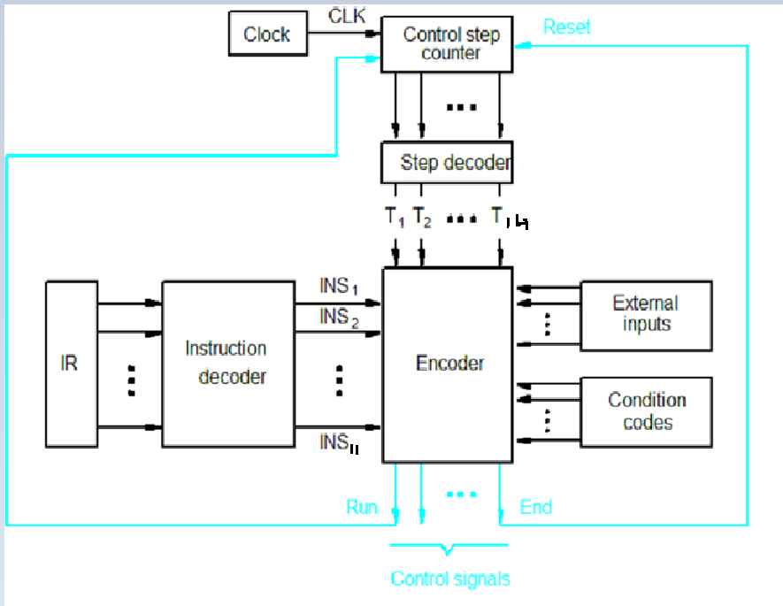
Hardwired Control Unit

Slide 18
Micro-Instructions
DOOR R01
PCout, MARin, READ, SELECT 1, ADD, Zin
Zout, PCin, Yin, WMFC
MDRout, IRin
R01out, SELECT 1, CMP
IF ZFLAG = 1 THEN OUT, END
SELECT 2, CMP, IF ZFLAG = 1 THEN OUT END
SELECT 3, CMP, IF ZFLAG = 1 THEN OUT END
OUT END
ENTERTAINMENT
PCout, MARin, READ, SELECT 1, ADD, Zin
Zout, PCin, Yin, WMFC
MDRout, IRin
IN, SELECT 1, CMP
IF ZFLAG = 1, THEN IN, SELECT 5, CMP
IF NFLAG THEN OUT, END
OUT, END
SELECT 2, CMP, IF ZFLAG =1 THEN IN,
SELECT 4, CMP, IF NFLAG =1 THEN OUT, END
OUT, END
SELECT 3, CMP, IF ZFLAG =1 THEN IN,
SELECT 6, CMP, IF NFLAG = 1 THEN OUT, END
OUT, END
FLY R01
PCout, MARin, READ, SELECT 1, ADD, Zin
Zout, PCin, Yin, WMFC
MDRout, IRin
OFFSETFIELD IRout, SELECT Y, ADD, Zin, IF RET THEN END
Zout, PCin, Yin, END
WEATHERFORECAST R01
PCout, MARin, READ, SELECT 1, ADD, Zin
Zout, PCin, Yin, WMFC
MDRout, IRin
R01out, SELECT 8, CMP
IF ZFLAG = 1 THEN OUT, END
SELECT 15, CMP, IF NFLAG = 1 THEN OUT, END
SELECT 20, CMP, IF NFLAG = 1 THEN OUT, END
SELECT 24, CMP, IF NFLAG = 1 THEN OUT, END
OUT, END

Slide 19
HVAC R01, R02
PCout, MARin, READ, SELECT 1, ADD, Zin
Zout, PCin, Yin, WMFC
MDRout, IRin
R01out, SELECT 1, CMP
IF ZFLAG = 1 THEN IN, R03in
R03out, SELECT 9, MUL, Zin
Zout, SELECT 5, DIV, Zin
Zout, SELECT 32, ADD, Zin
Zout, OUT
R03out, SELECT 30, CMP
IF PFLAG = 1 THEN OUT, END
SELECT 10, CMP, IF NFLAG = 1 THEN OUT, END
OUT, END
ELSE SELECT 2, CMP
IF ZFLAG = 1 THEN R02out
OUT, END
SELECT 3, CMP IF ZFLAG = 1, THEN R02out
OUT, END
SETREMINDER R03
PCout, MARin, READ, SELECT 1, ADD, Zin
Zout, PCin, Yin, WMFC
MDRout, IRin
R01out, MARin
R03out, MDRin, WRITE
WMFC, END
REMINDER
PCout, MARin, READ, SELECT 1, ADD, Zin
Zout, PCin, Yin, WMFC
MDRout, IRin
R03out, MARin, READ
WMFC
MDRout
OUT, END
MOVE R01, R02
PCout, MARin, READ, SELECT 1, ADD, Zin
Zout, PCin, Yin, WMFC
MDRout, IRin
R01out, R02in, END
HALT
PCout, MARin, READ, SELECT 1, ADD, Zin
Zout, PCin, Yin, WMFC
MDRout, IRin
HLT,END

Slide 20
WATERCLOSET R01
PCout, MARin, READ, SELECT 1, ADD, Zin
Zout, PCin, Yin, WMFC
MDRout, IRin
R01out, Yin, SELECT 25, CMP
IF PFLAG = 1 THEN IN, SELECT Y, SUB, Zin
Zout, R01in, END
IF NFLAG = 1 THEN IN, SELECT Y, ADD, Zin
Zout, R01in, END
INFO
PCout, MARin, READ, SELECT 1, ADD, Zin
Zout, PCin, Yin, WMFC
MDRout, IRin
IN, SELECT 1, CMP
IF ZFLAG = 1 THEN OUT, END
SELECT 2, CMP, IF ZFLAG = 1 THEN OUT, END
OUT, END
IRRIGATION
PCout, MARin, READ, SELECT 1, ADD, Zin
Zout, PCin, Yin, WMFC
MDRout, IRin
IN, SELECT 2, CMP
IF ZFLAG = 1 THEN OUT END
OUT END
KITCHEN
PCout, MARin, READ, SELECT 1, ADD, Zin
Zout, PCin, Yin, WMFC
MDRout, IRin
IN, SELECT 2, CMP
IF ZFLAG = 1 THEN OUT END
OUT END
SETTINGS R01
PCout, MARin, READ, SELECT 1, ADD, Zin
Zout, PCin, Yin, WMFC
MDRout, IRin
R03out, Yin
R01out, SELECT Y, CMP
IF ZFLAG = 1 THEN IN, SELECT 1, CMP
IF ZFLAG = 1 THEN R02out, Yin
IN, SELECT Y, ADD, Zin
Zout, R02in, END
SELECT 2, CMP, IF ZFLAG = 1 THEN R02out, Yin,
IN, SELECT Y, SUB, Zin
Zout, R02in, END
SELECT 3, CMP, IF ZFLAG = 1 THEN IN, R03in, END
OUT END

Slide 21
LIGHT R01, R02
PCout, MARin, READ, SELECT 1, ADD, Zin
Zout, PCin, Yin, WMFC
MDRout, IRin
R01out, SELECT 1, CMP
IF ZFLAG = 1 THEN R02out, SET LIGHT1, END
SELECT 2, CMP, IF ZFLAG = 1 THEN R02out, SET LIGHT2, END
SELECT 3, CMP, IF ZFLAG = 1 THEN R02out, SET LIGHT3, END
SELECT 4, CMP, IF ZFLAG = 1 THEN R02out, SET LIGHT4, END
OUT END

Slide 22
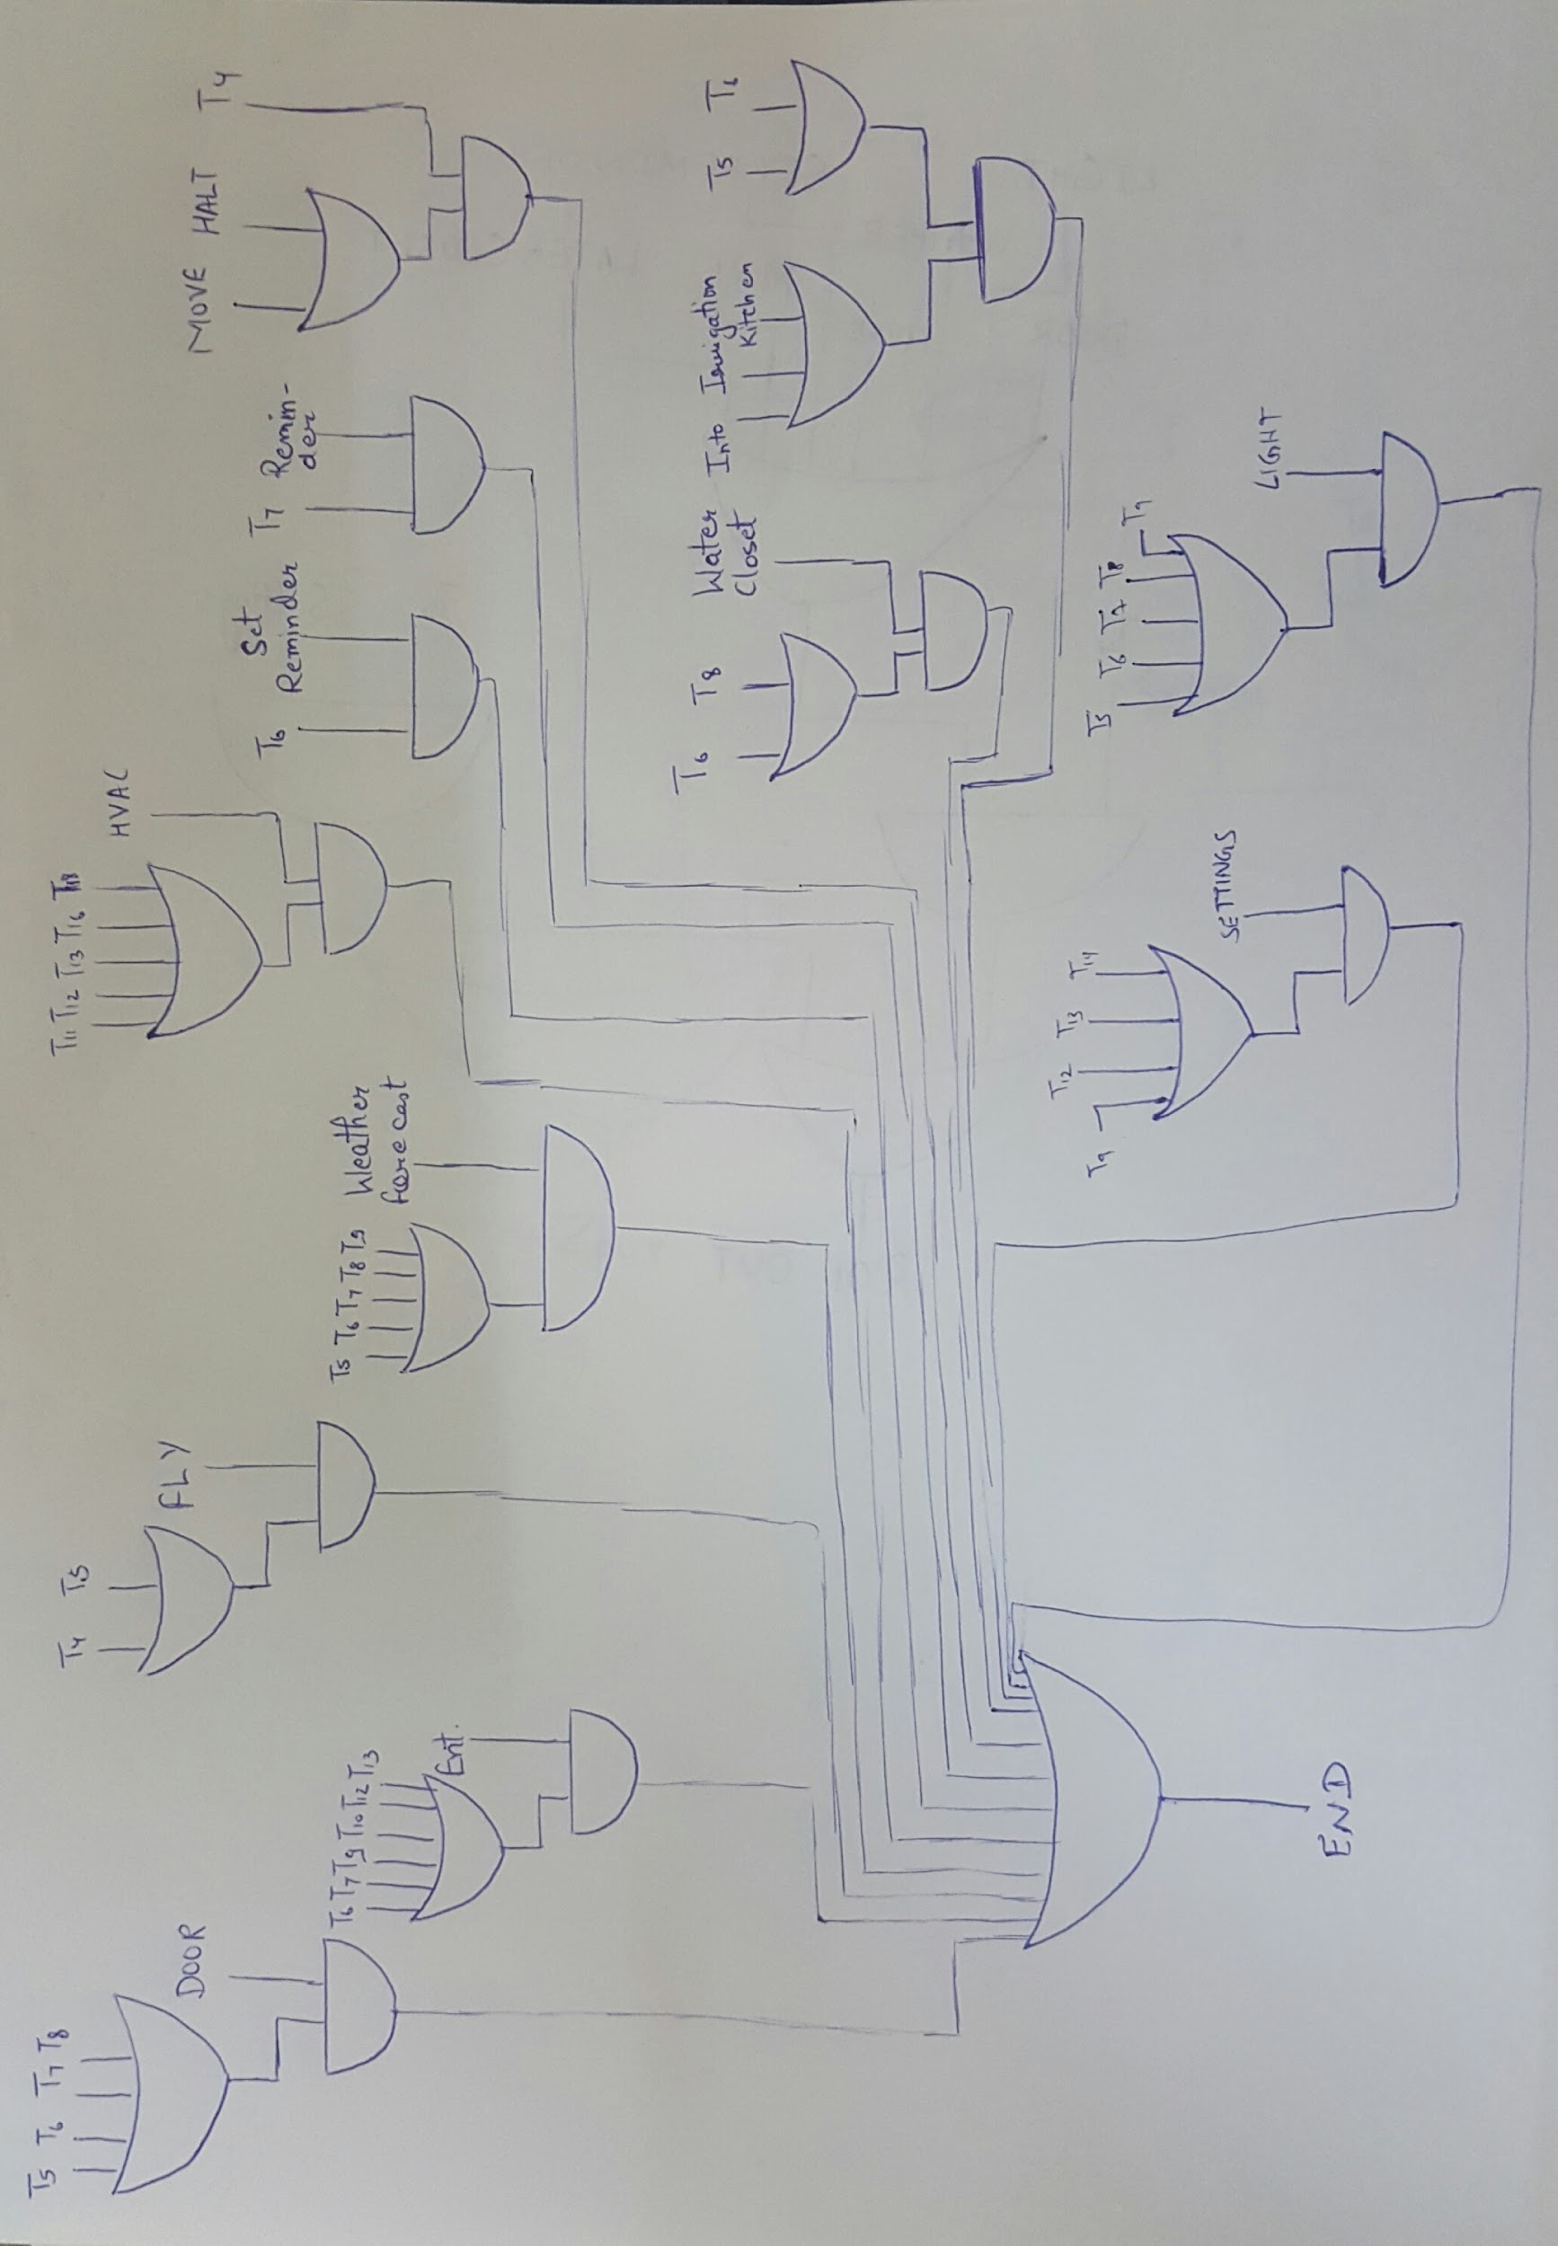
Hardwired Control Signals
END

Slide 23
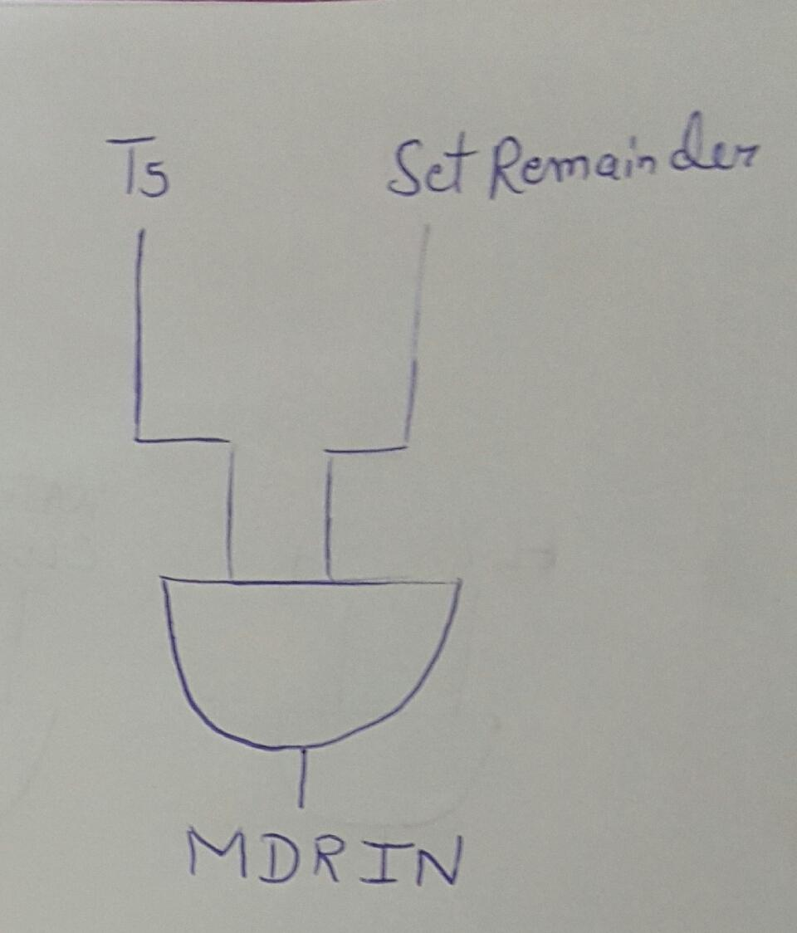
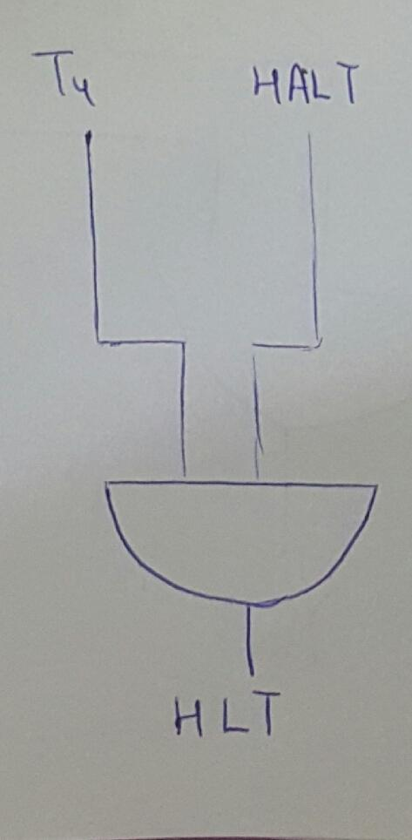
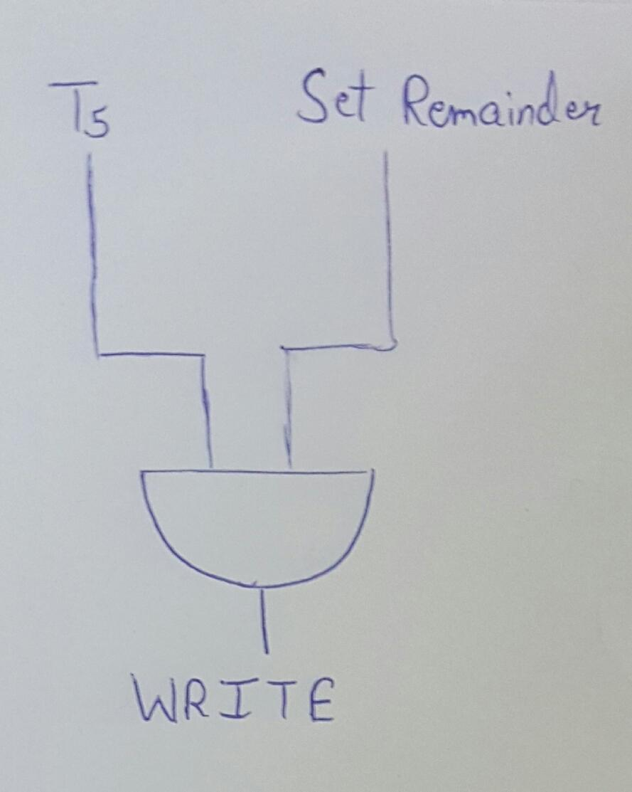
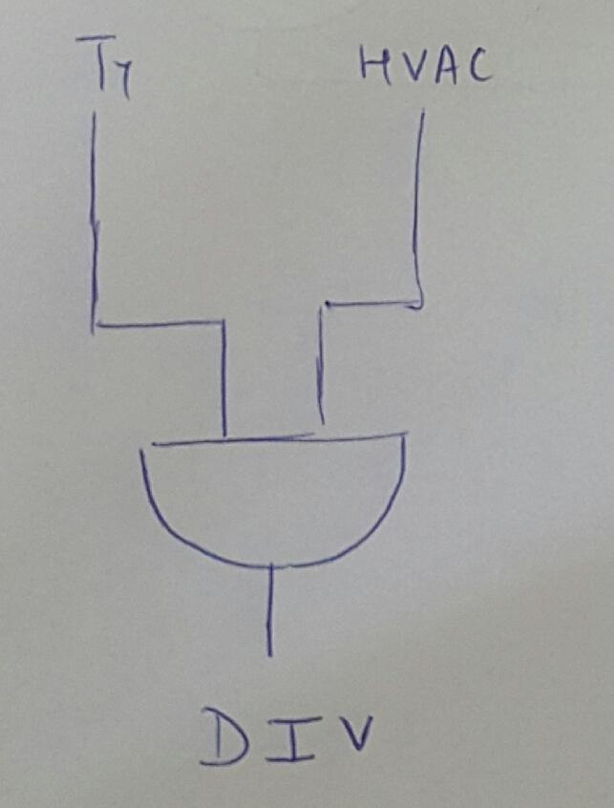
2. MDR_{IN}
3. WRITE
4. HALT
5. DIV

Slide 24
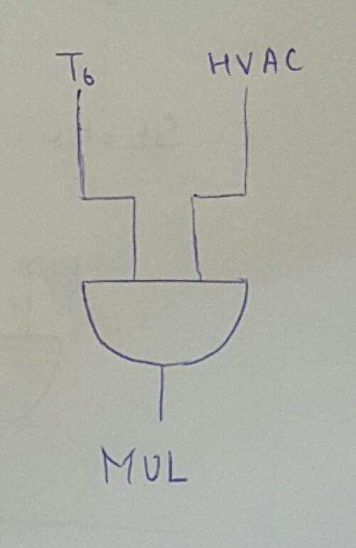
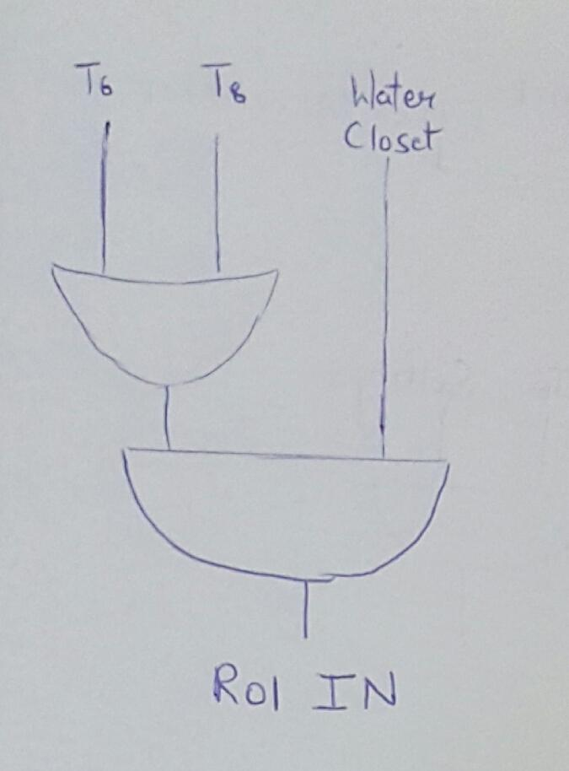
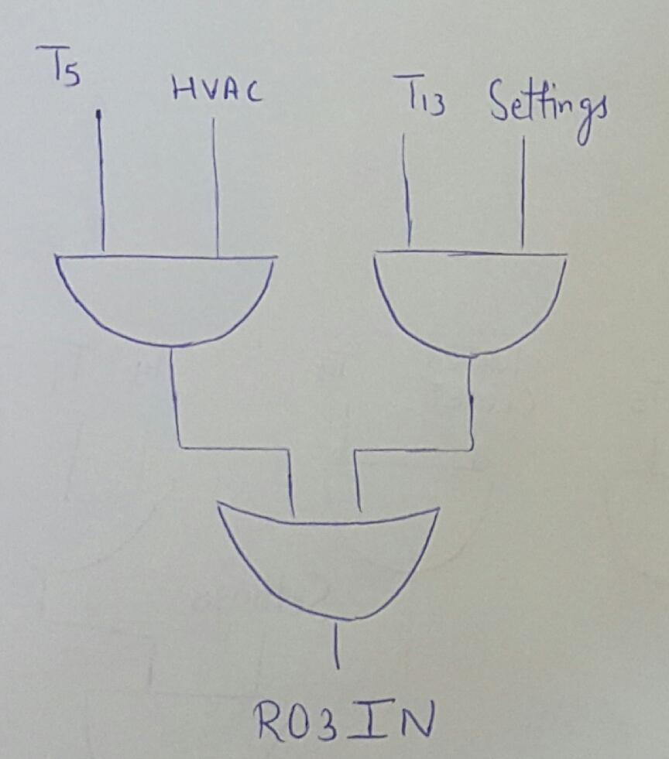
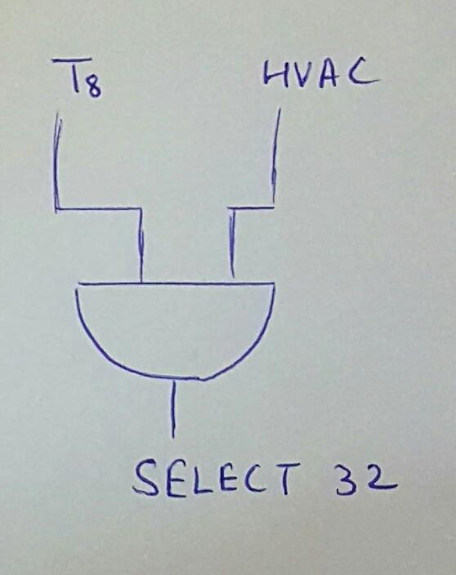
6. MUL
7. R03_{IN}
8. R01_{IN}
9. SELECT 32

Slide 25
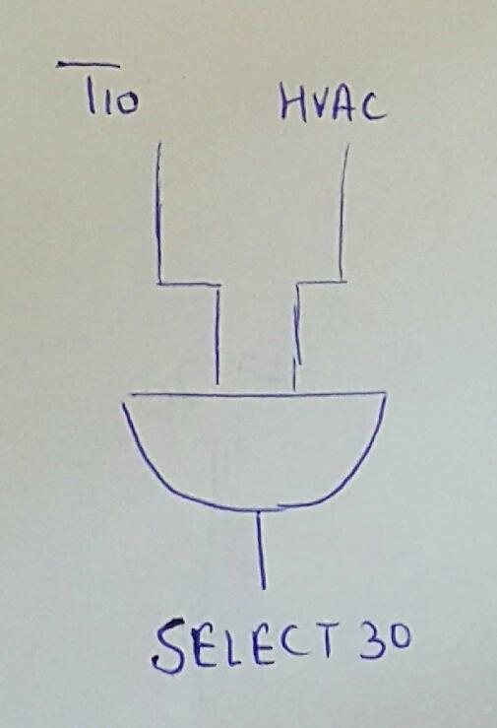
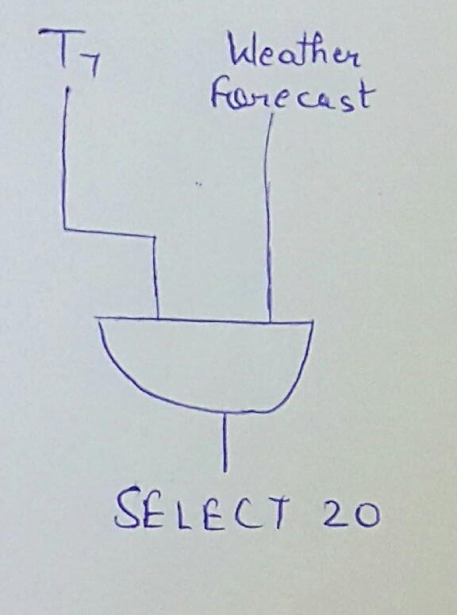
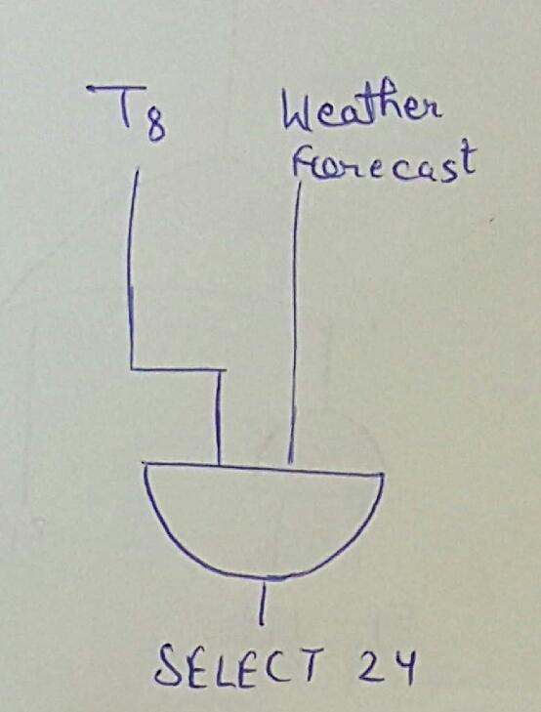
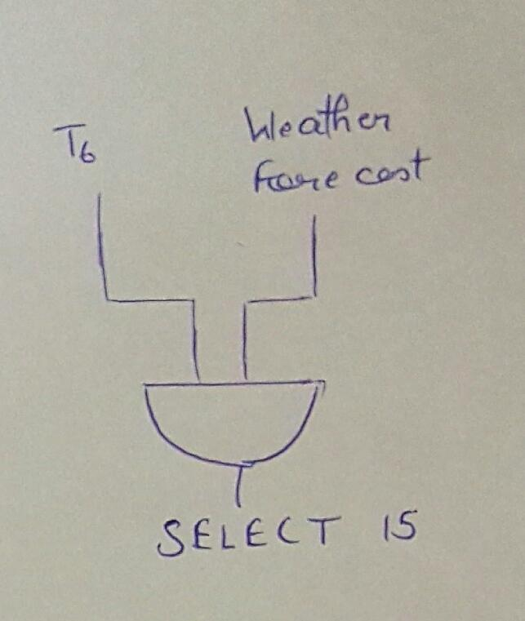
10. SELECT 30
11. SELECT 24
12. SELECT 20
13. SELECT 15

Slide 26
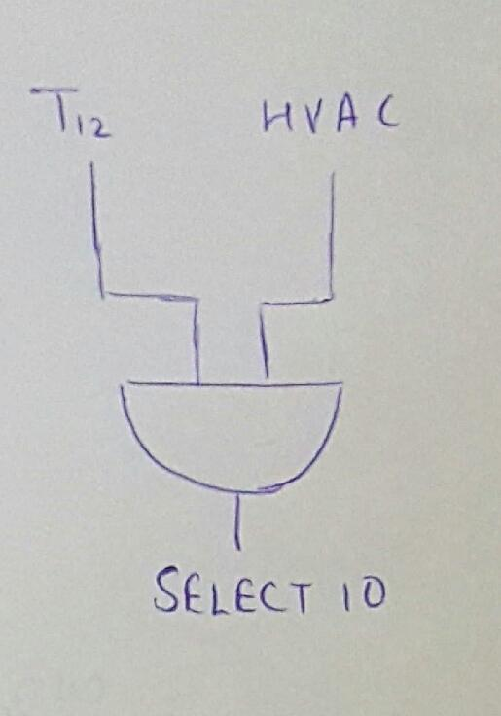
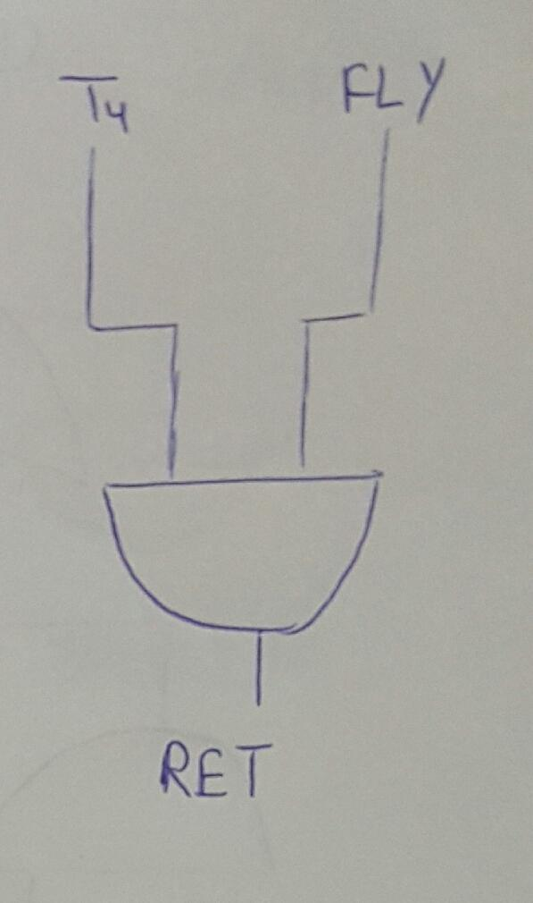
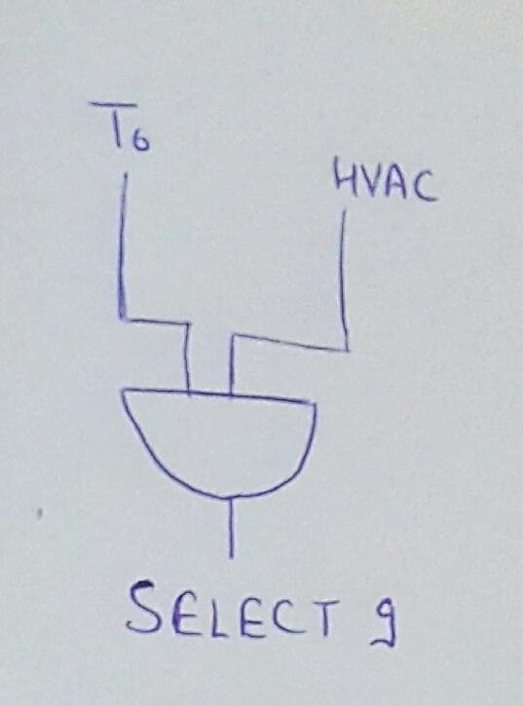
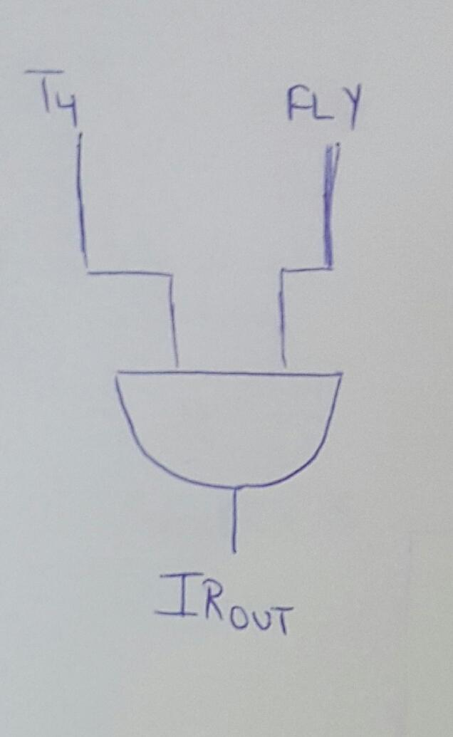
14. SELECT 10
15. SELECT 9
16. RET
17. IR_{OUT}

Slide 27
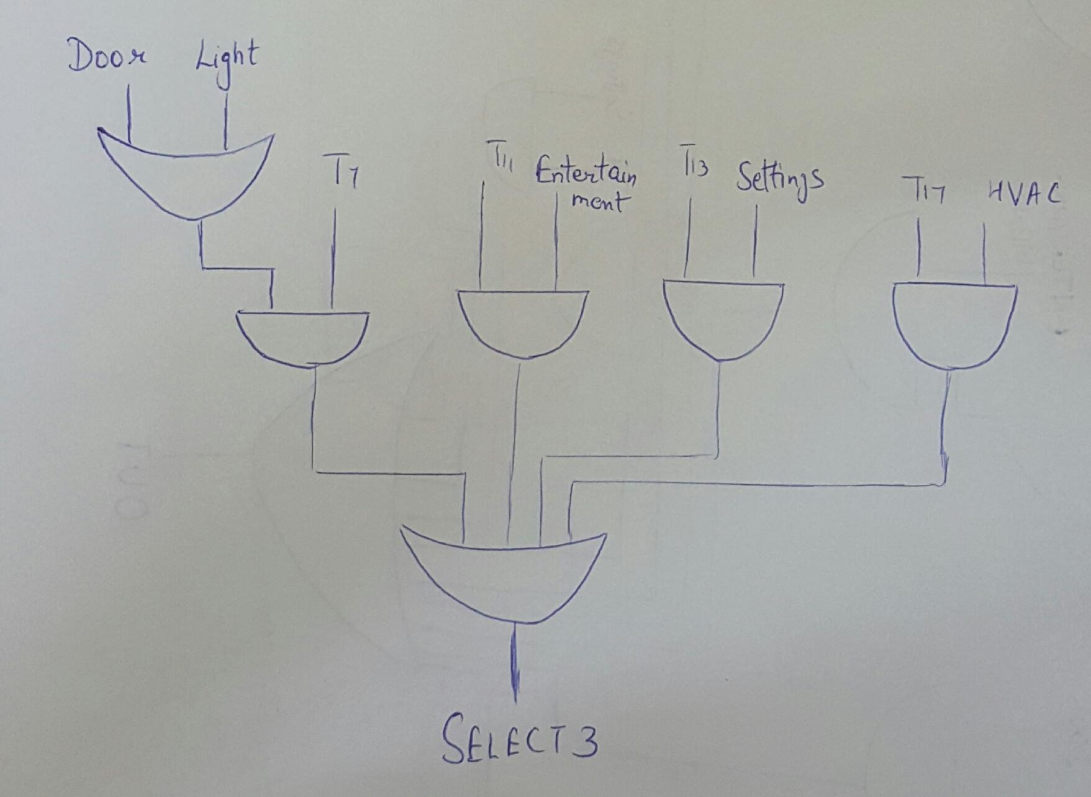
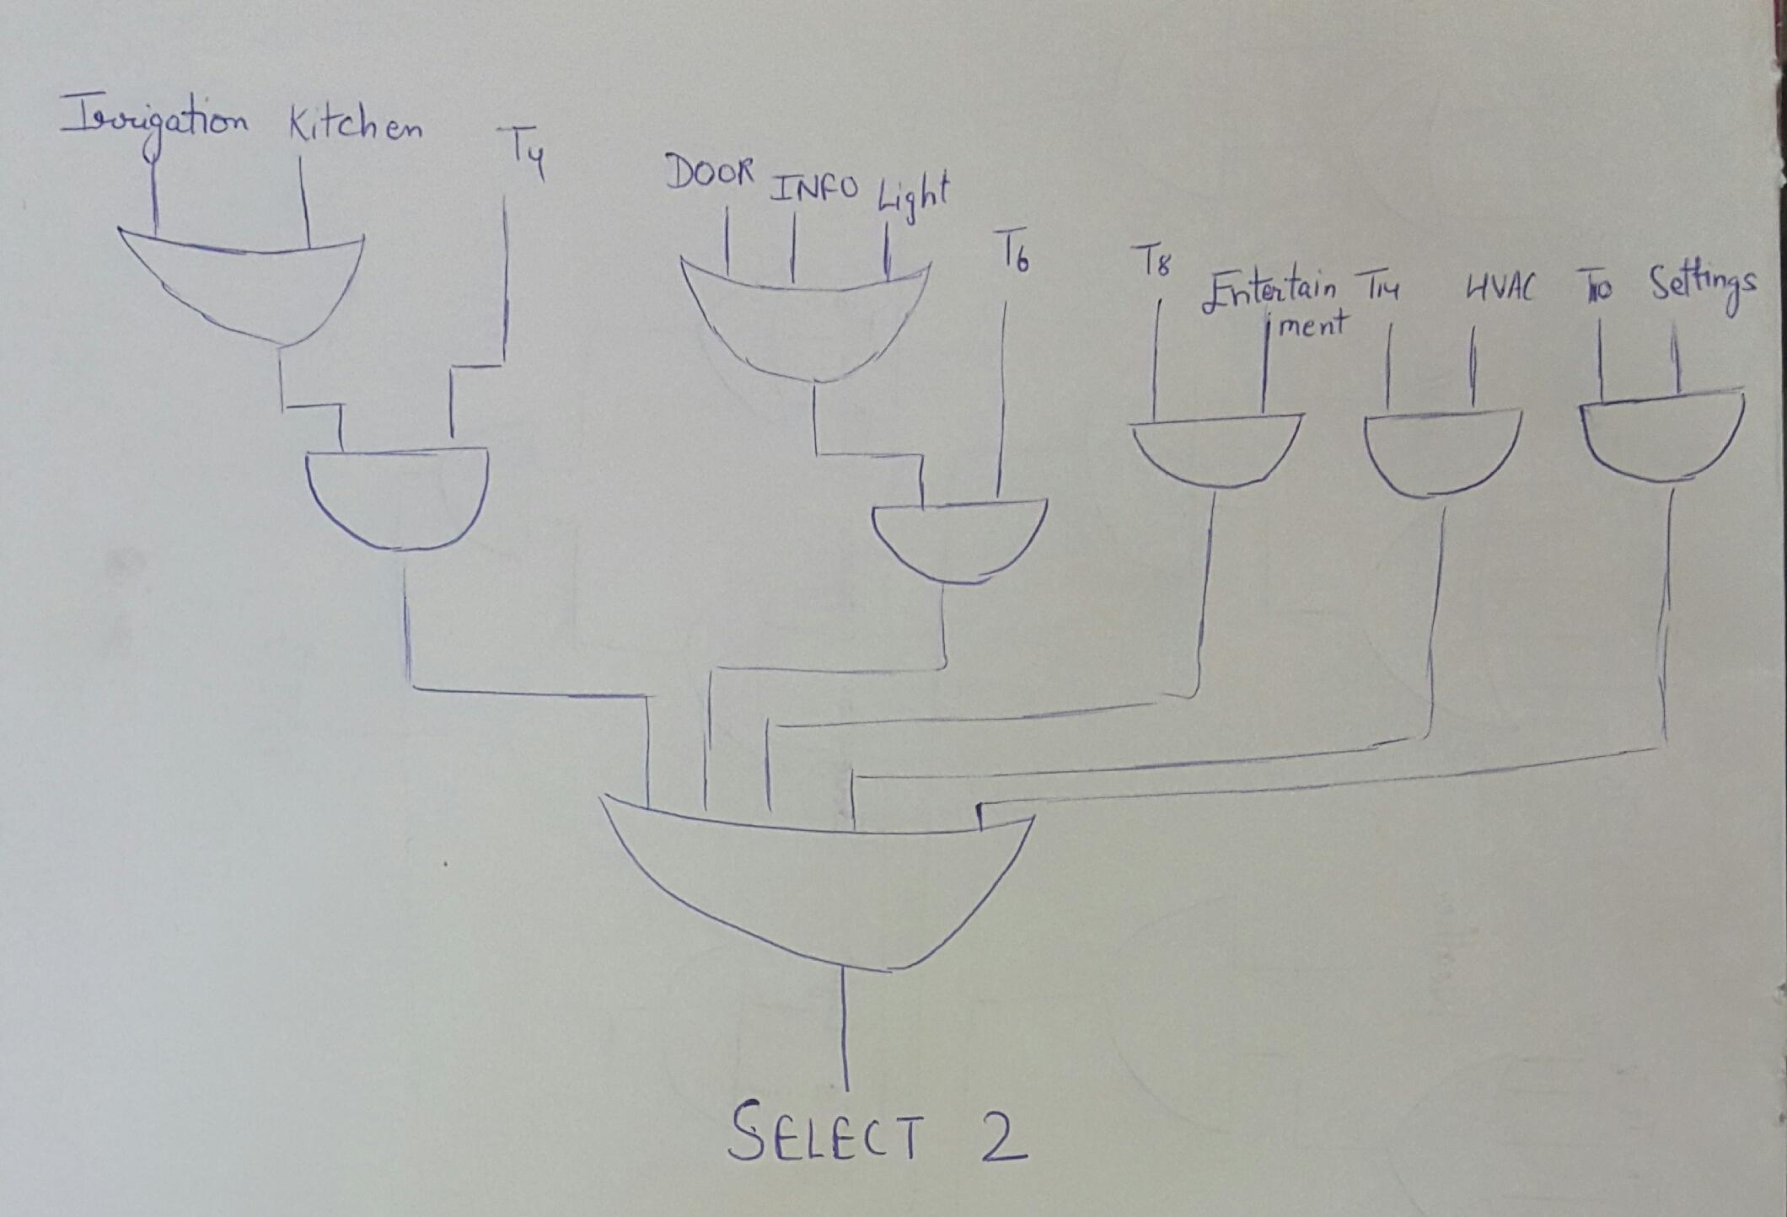
18. SELECT 3
19. SELECT 2

Slide 28
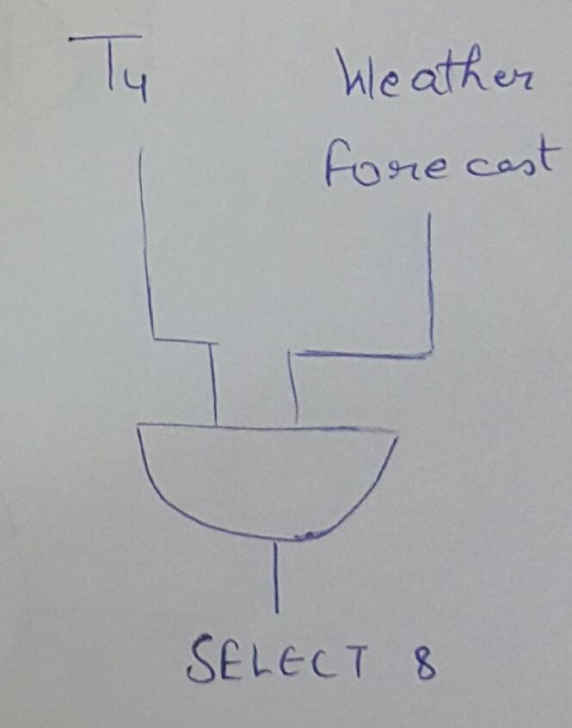
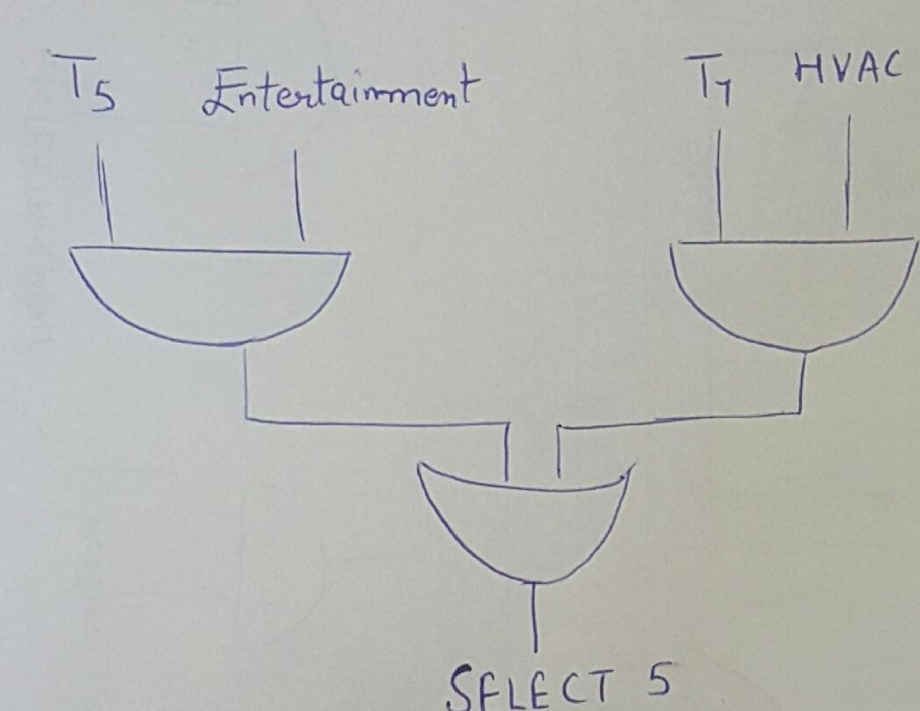
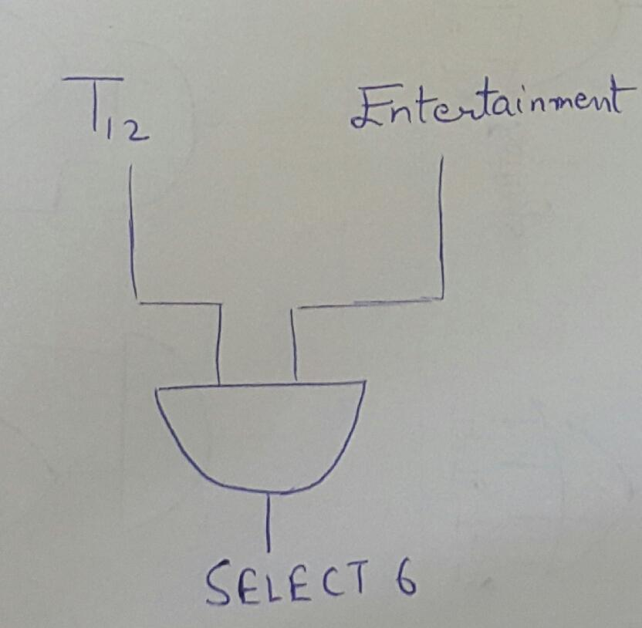
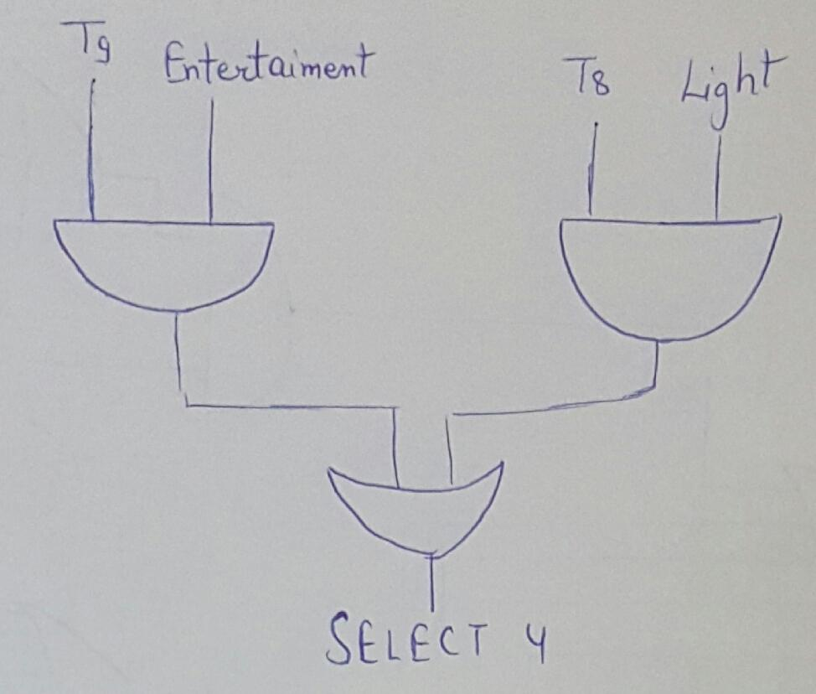
20. SELECT 8
21. SELECT 6
22. SELECT 5
23. SELECT 4

Slide 29
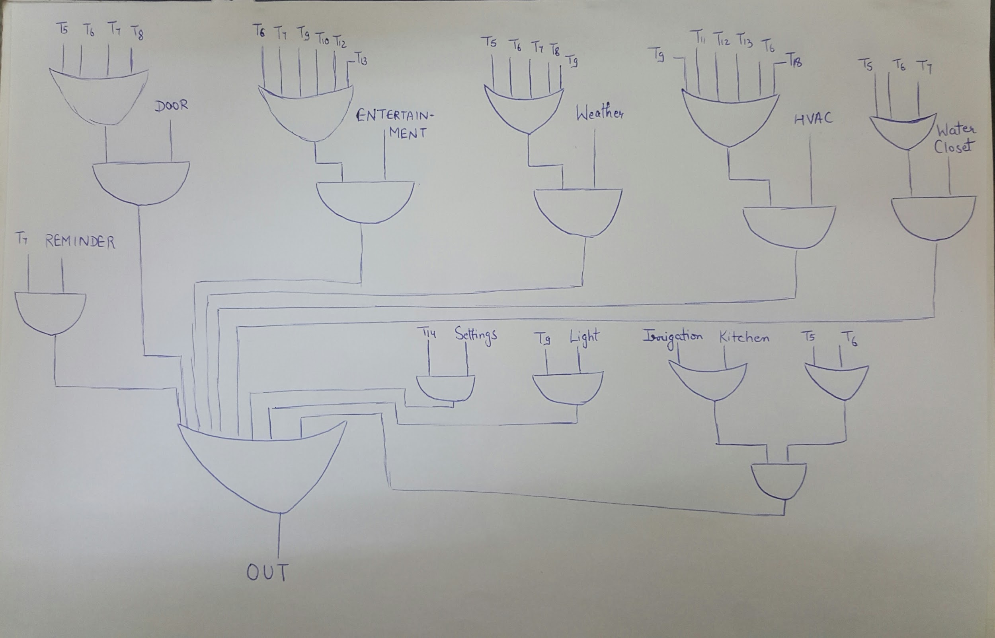
24. OUT

Slide 30
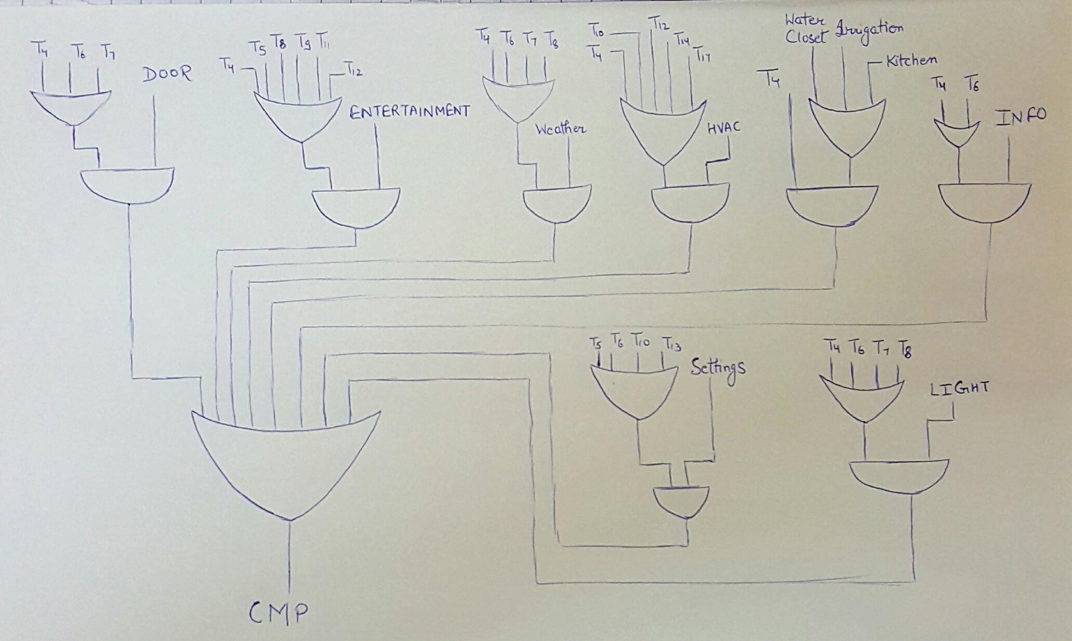
25. CMP

Slide 31
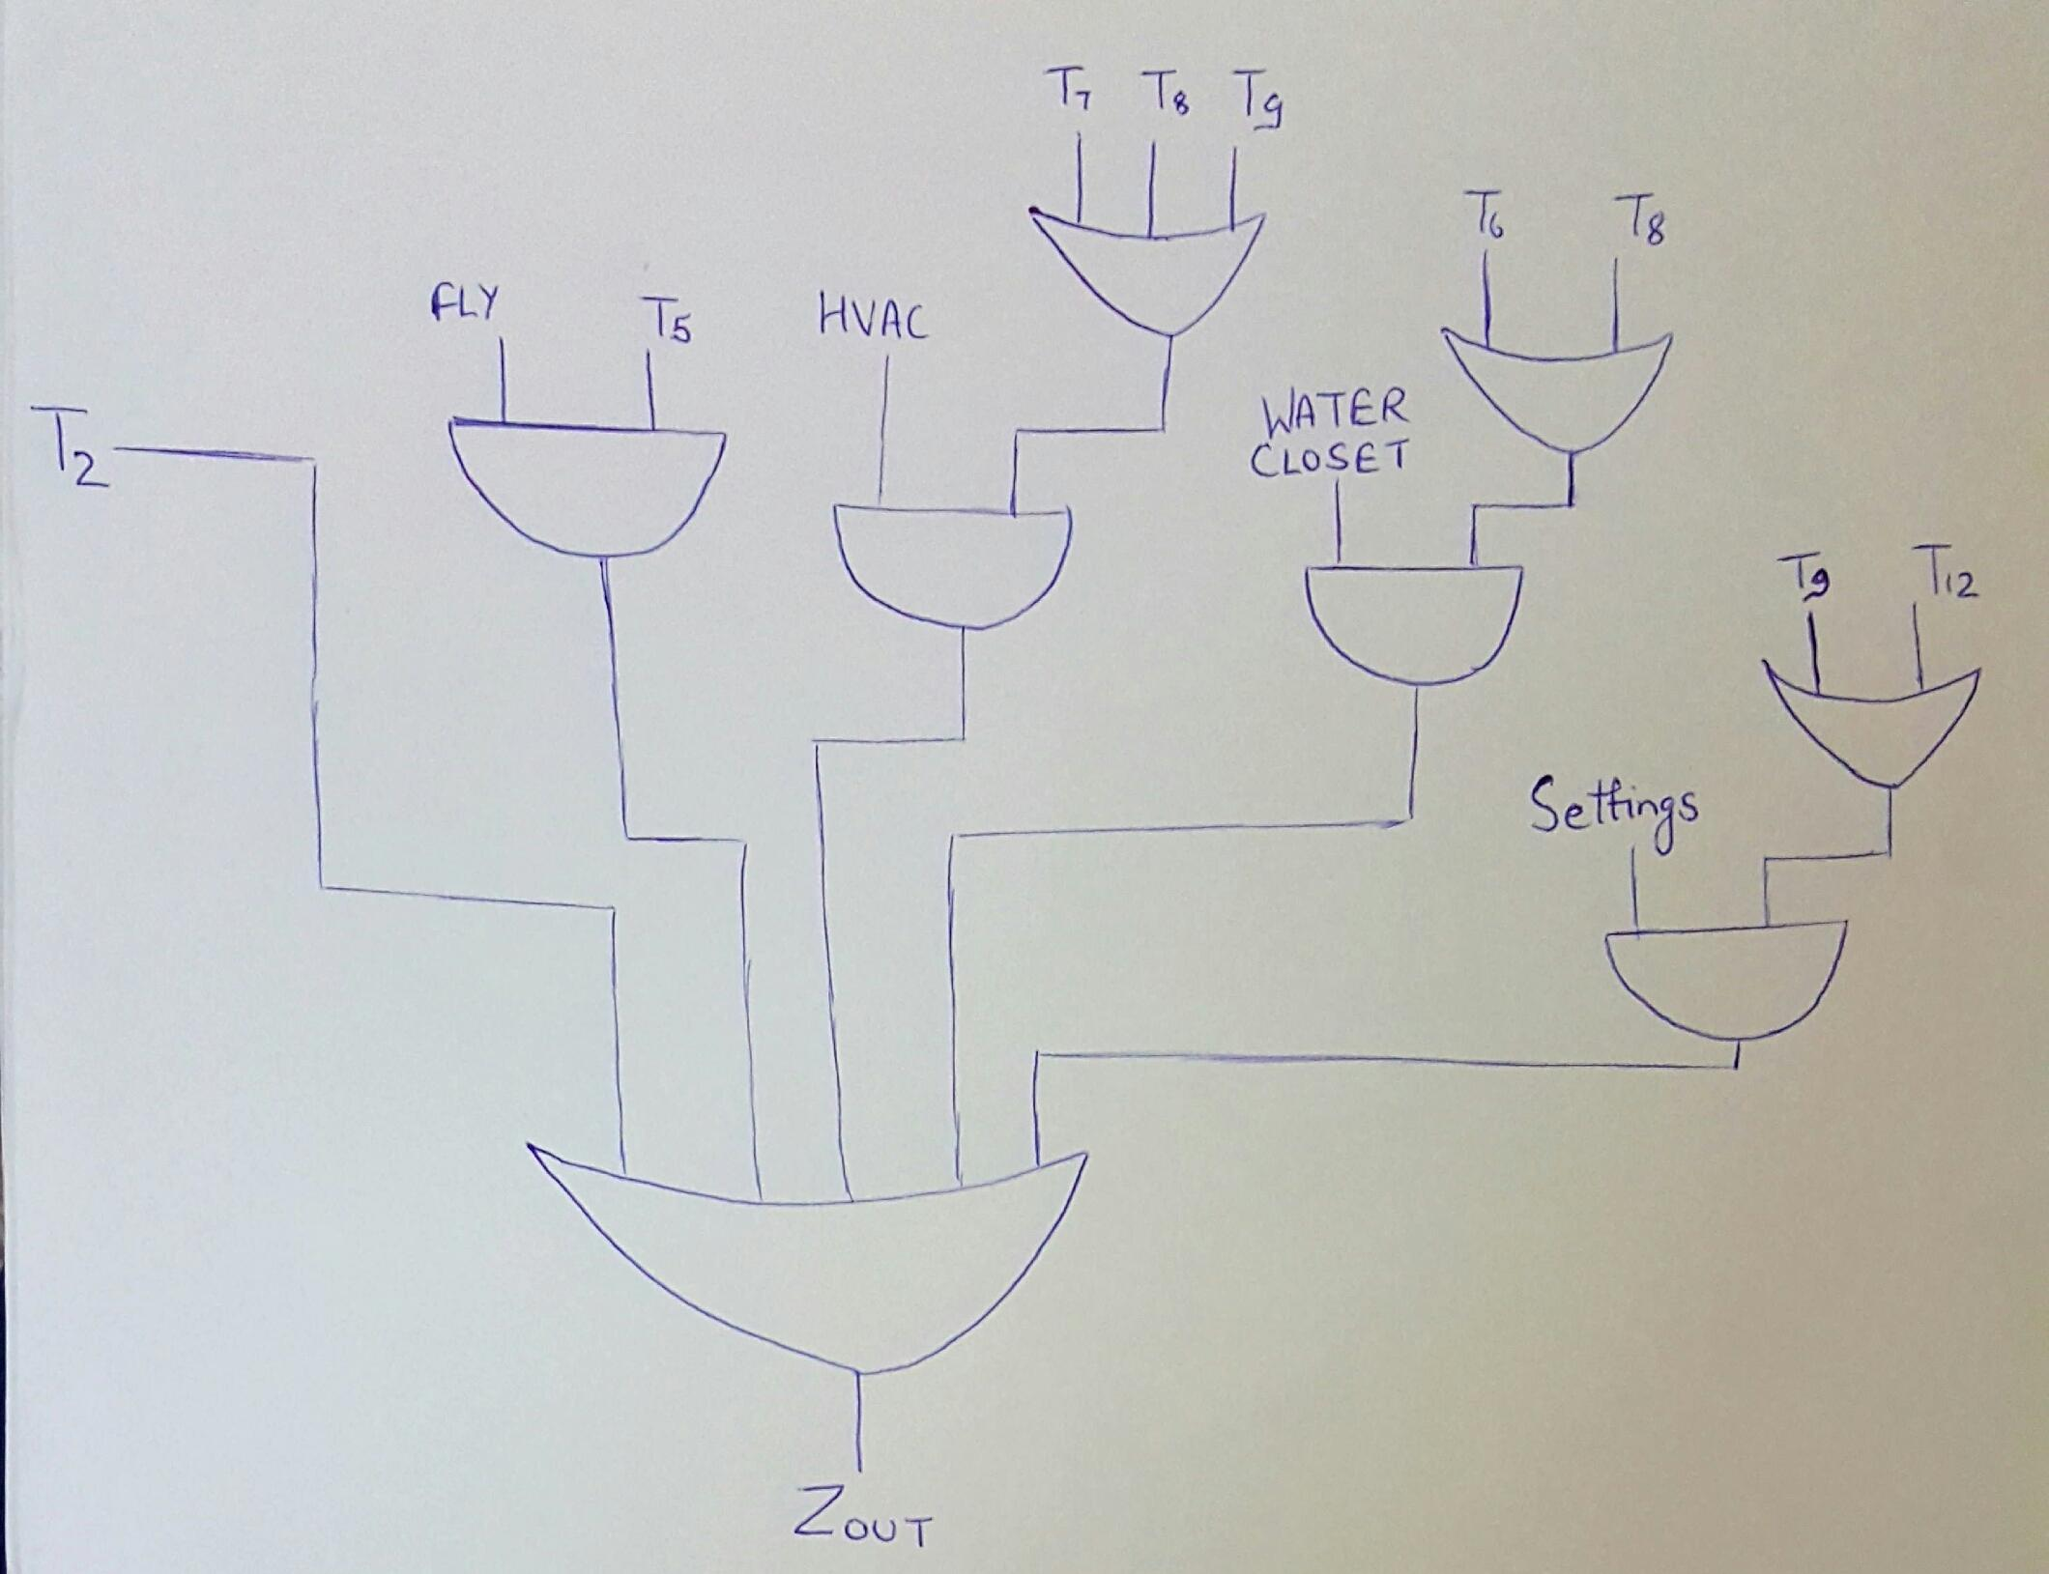
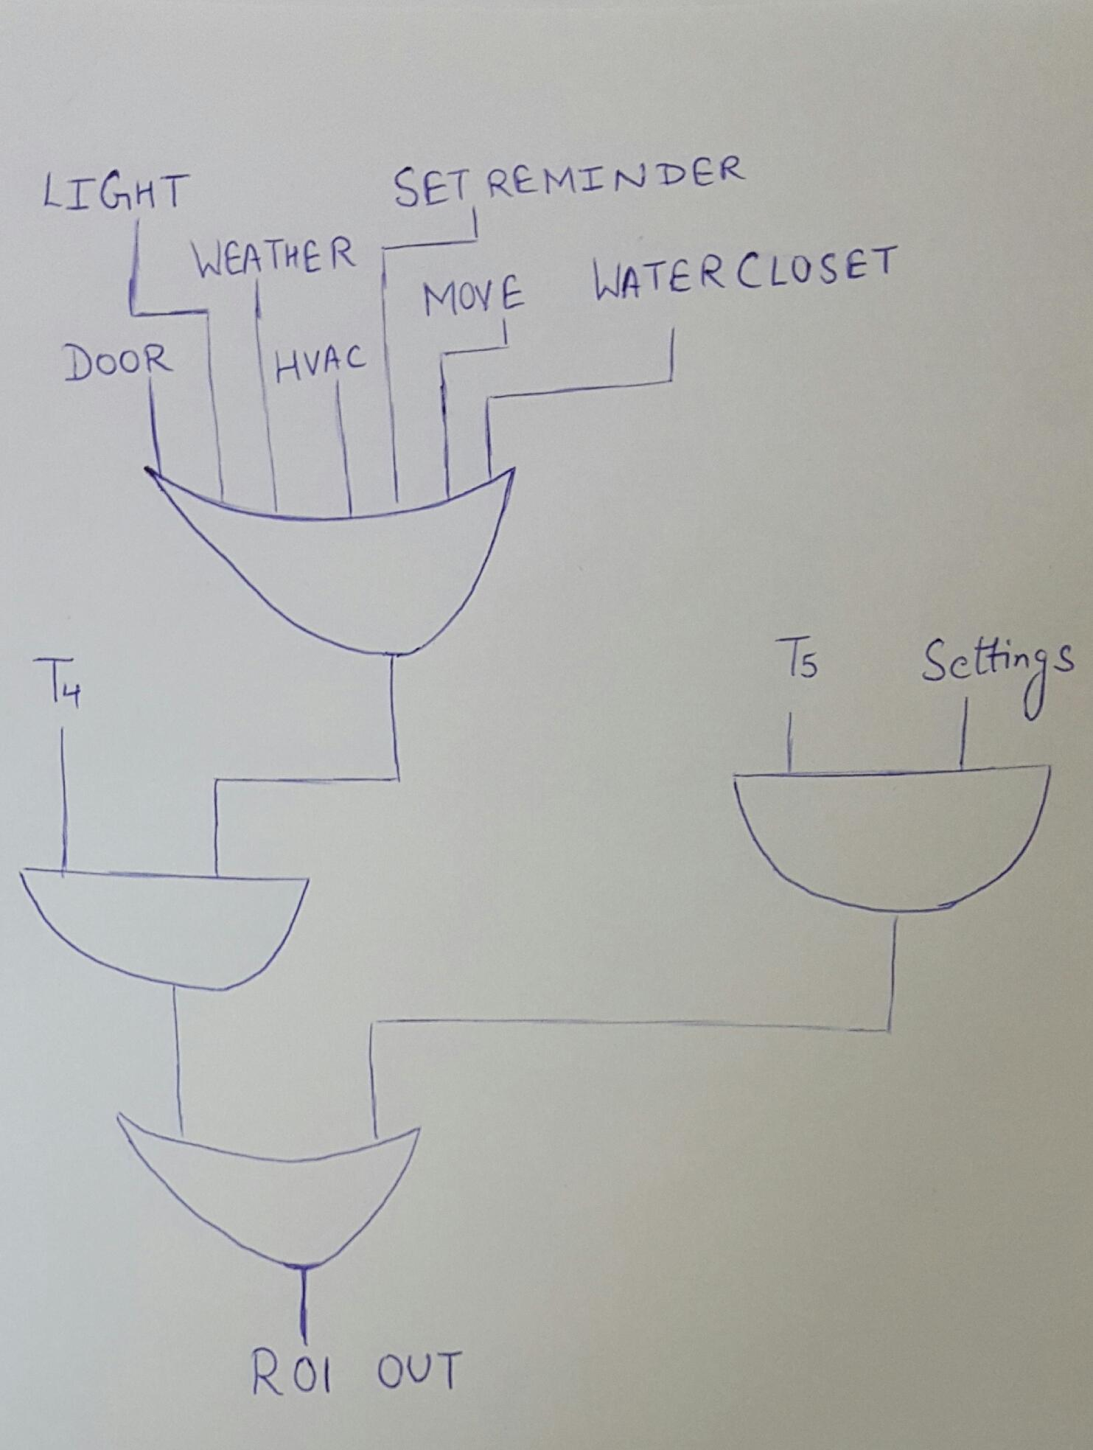
26. Z_{OUT}
27. R01_{OUT}

Slide 32
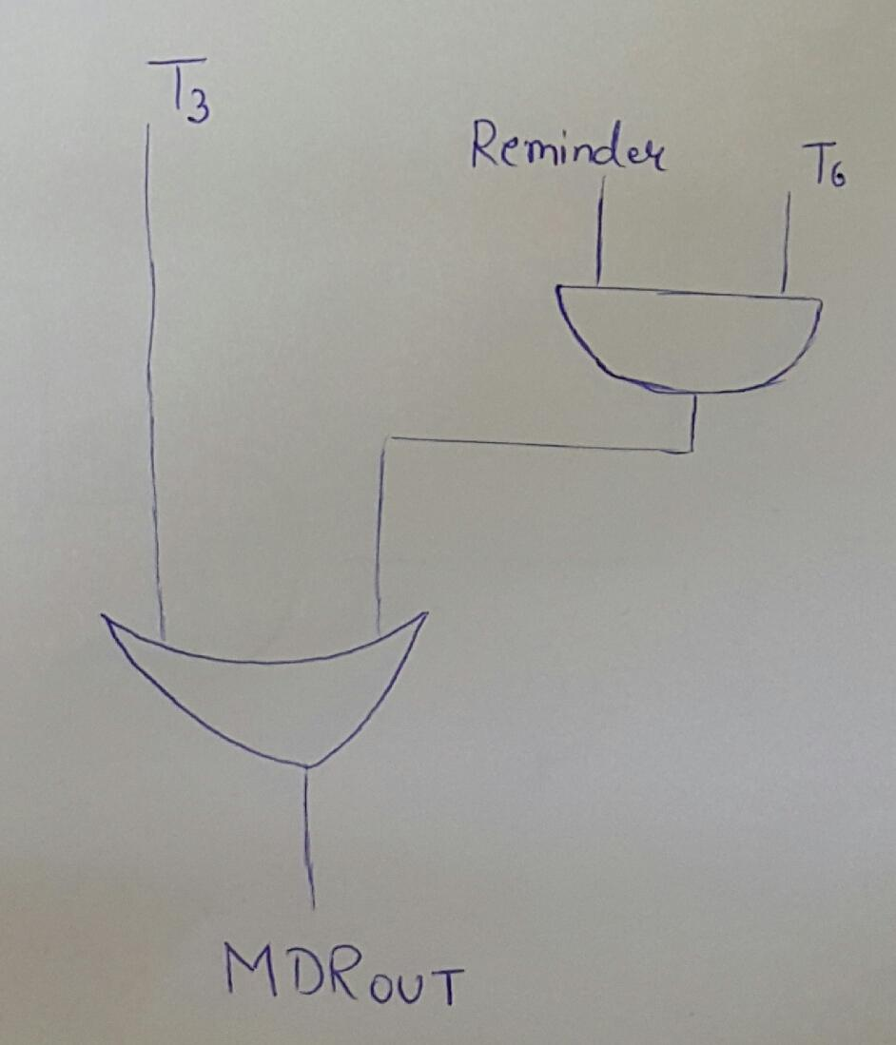
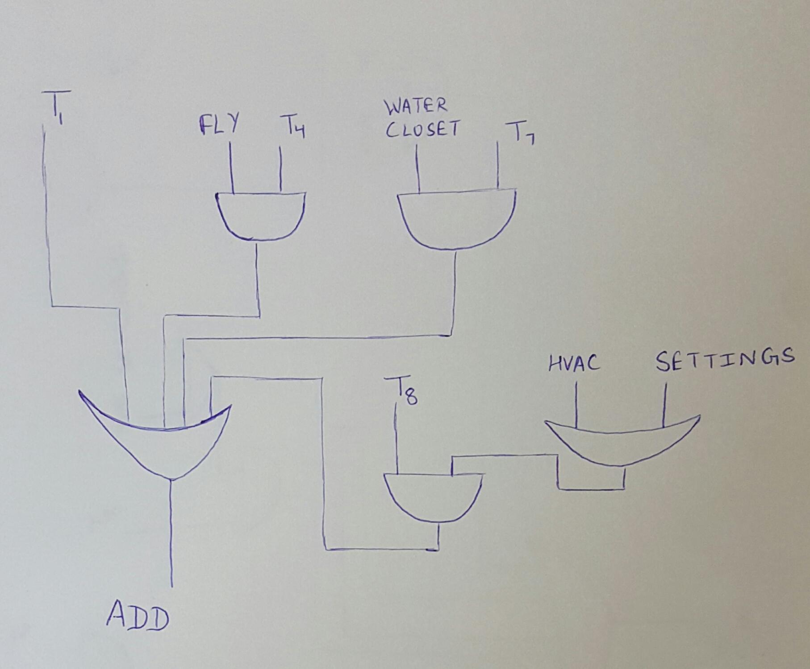
28. MDR_{OUT}
29. ADD

Slide 33
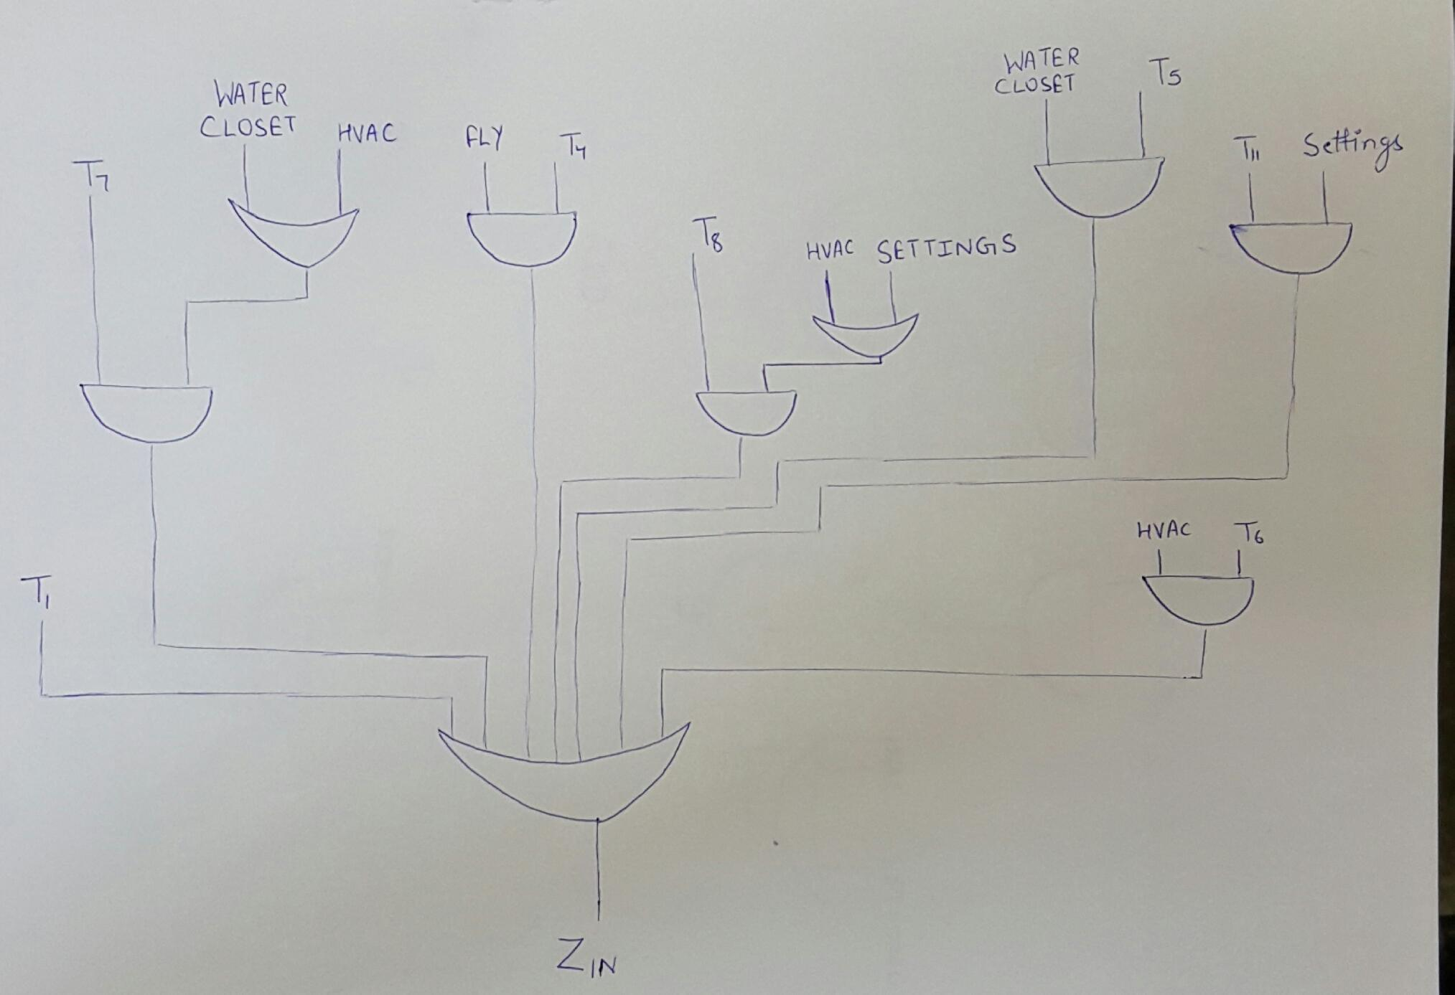
30. Z_{IN}

Slide 34
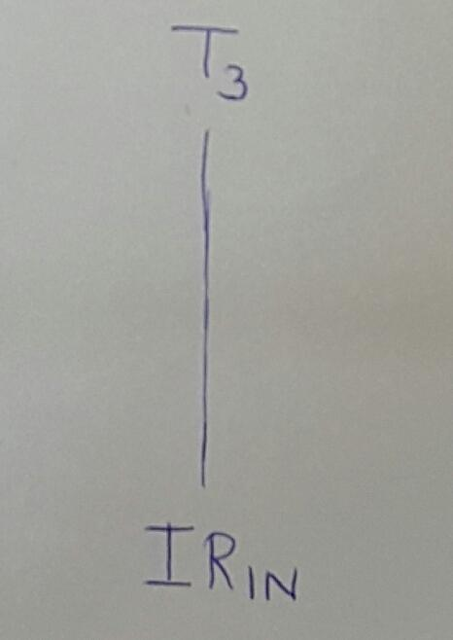
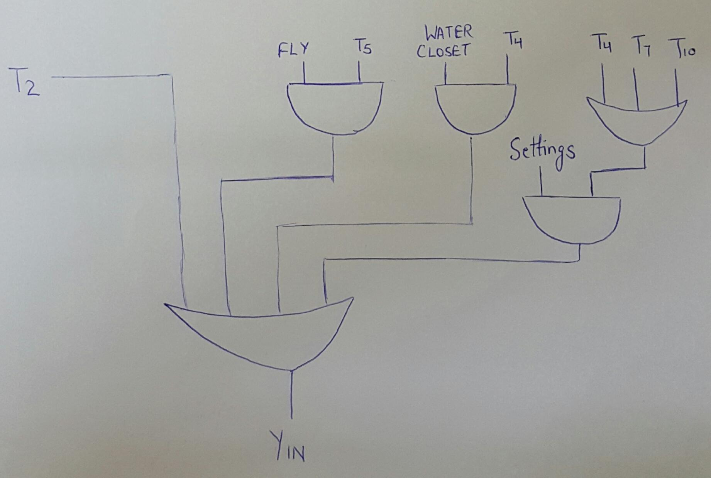
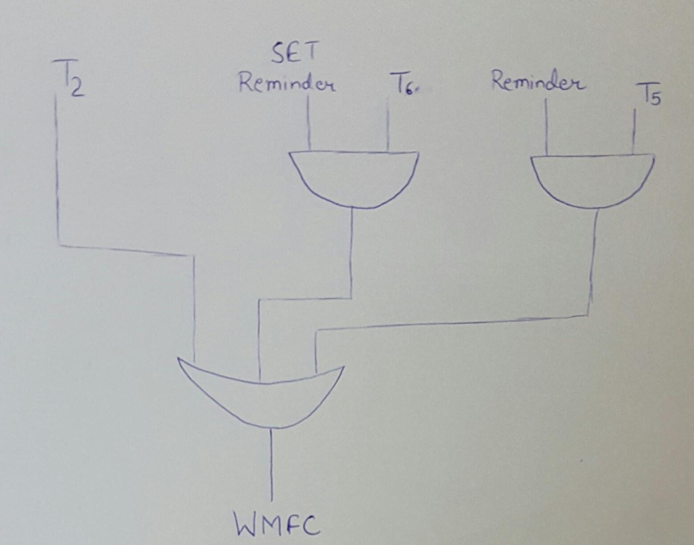
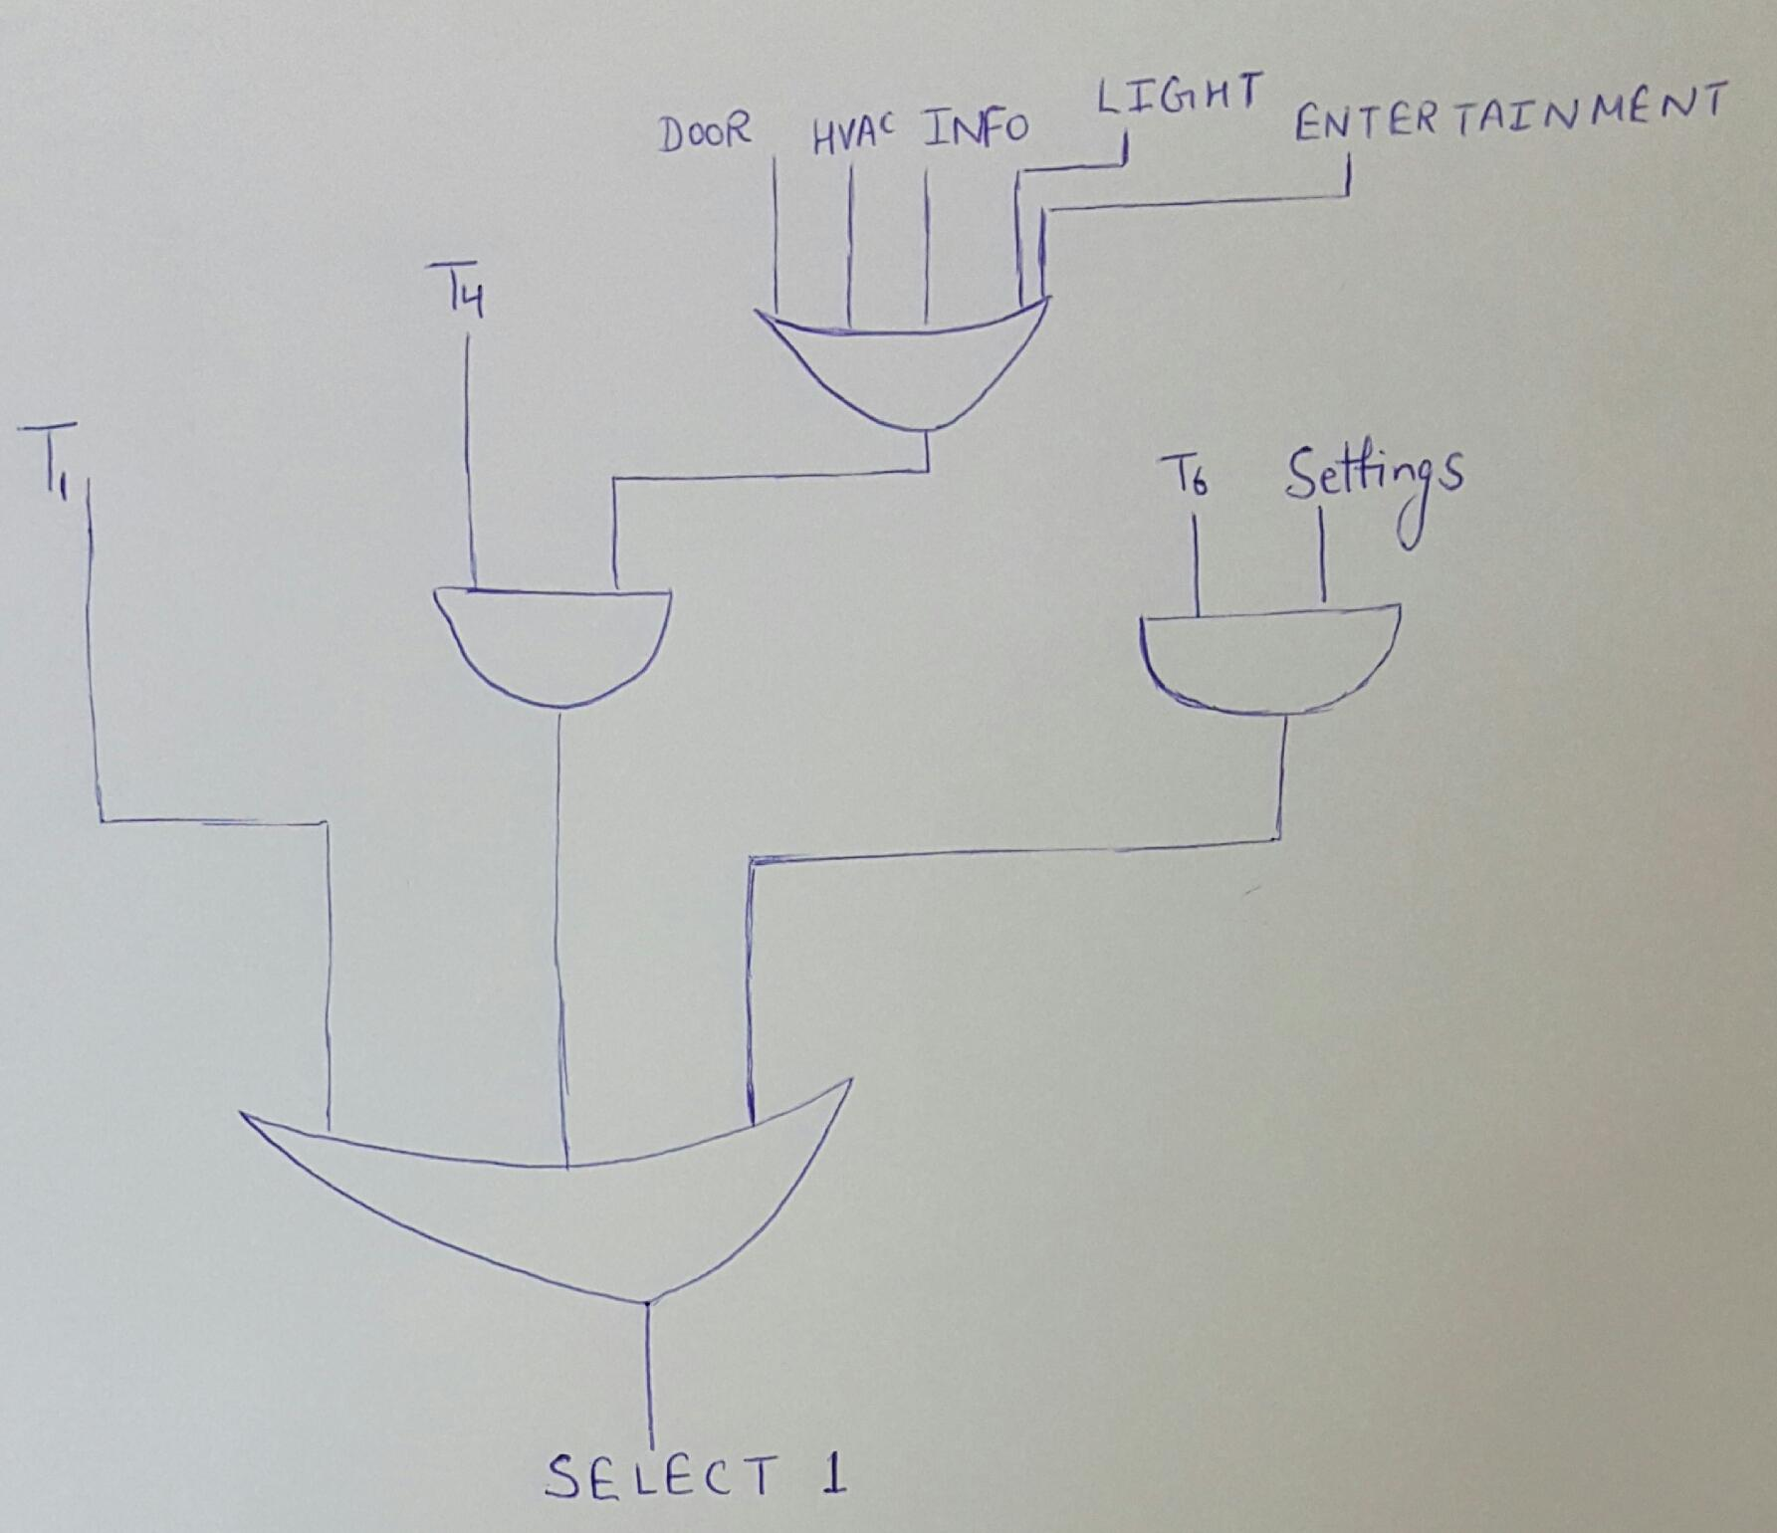
31. IR_{IN}
32. WMFC
33. Y_{IN}
34. SELECT 1

Slide 35
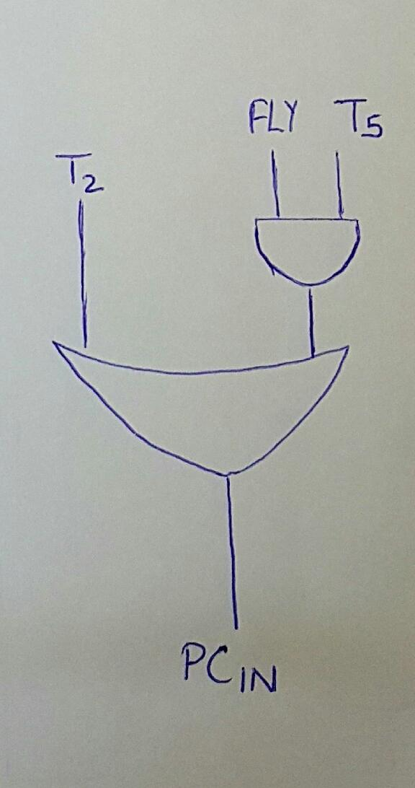
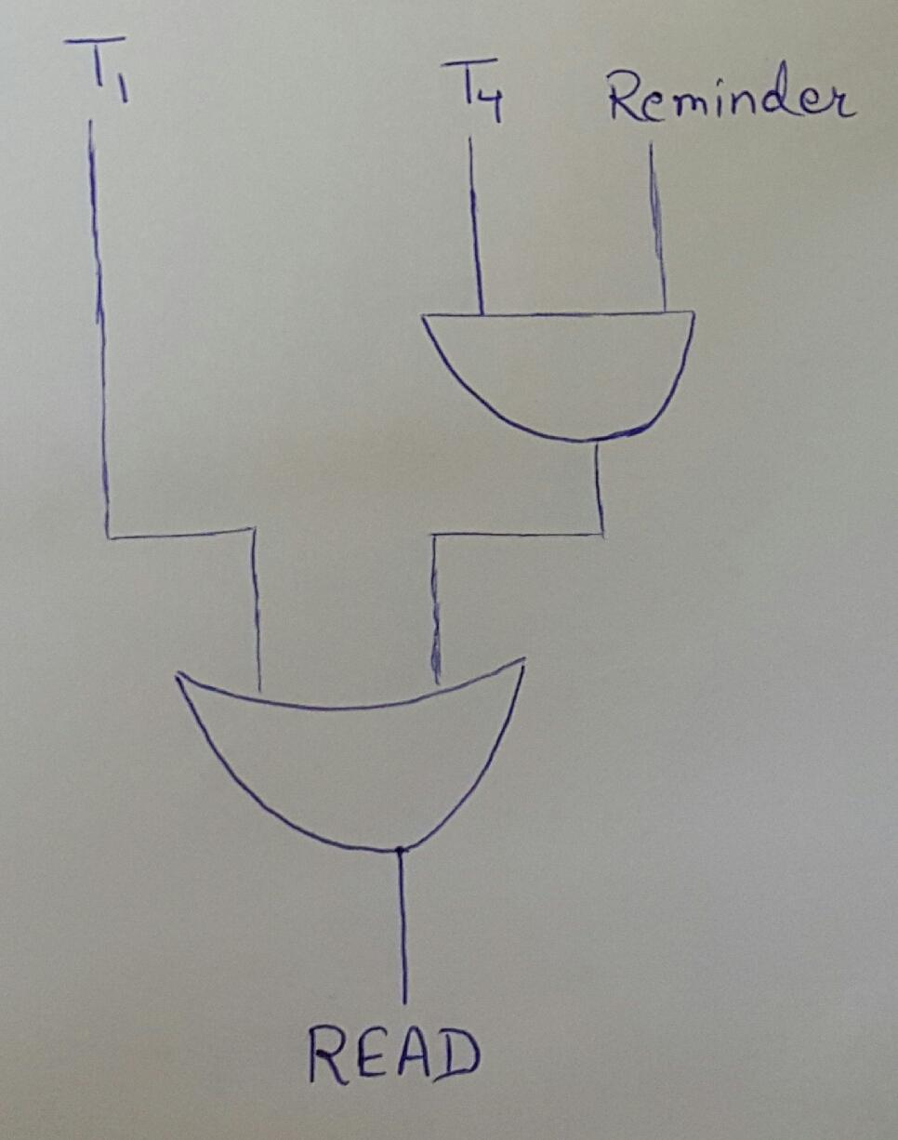
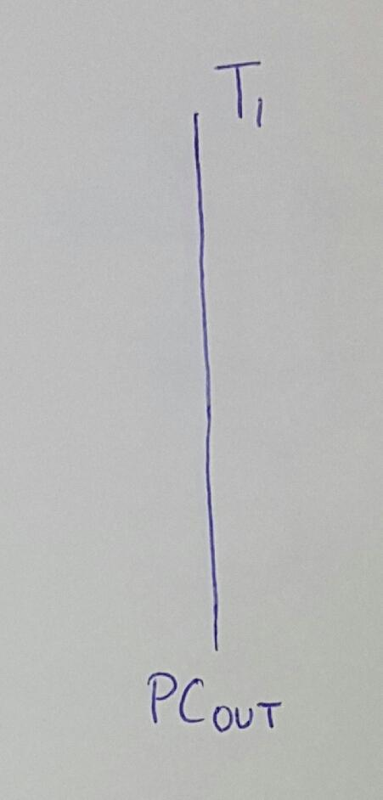
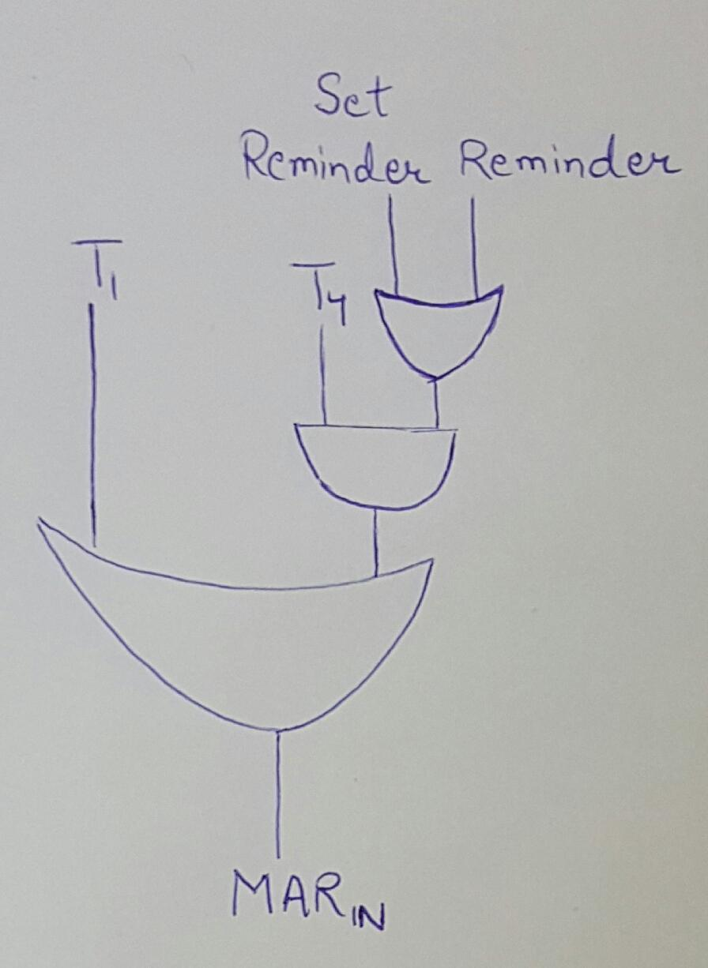
35. PC_{IN}
36. PC_{OUT}
37. READ
37. MAR_{IN}

Slide 36
THANK YOU ☺
THE END

